Slide 1
Jeffrey Holmes and Geoff Turner
April 5, 2013

Slide 2
Middlemist, Knowles, & Matter (1976)

Slide 3
Zajonc, Heingartner, & Herman (1969)

Slide 4
Chen (1937)

Slide 5
Travers & milgram (1969)

Slide 6
Moseley et al. (2002)

Slide 7
Clark & Hatfield (1989)

Slide 8
MINAMI & DALLENBACH (1946)

Slide 9
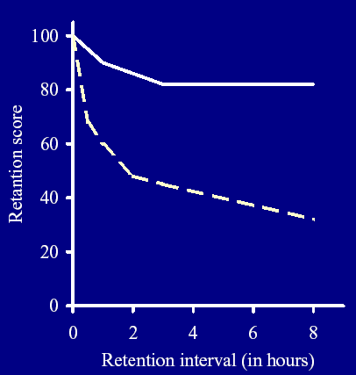
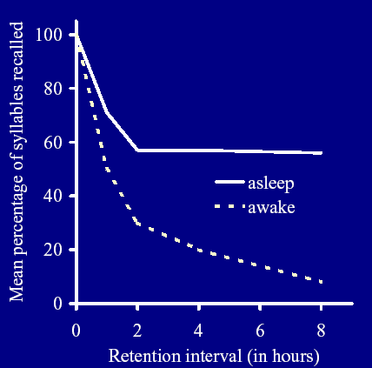
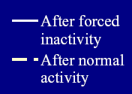
Cockroaches
College Students

Slide 10
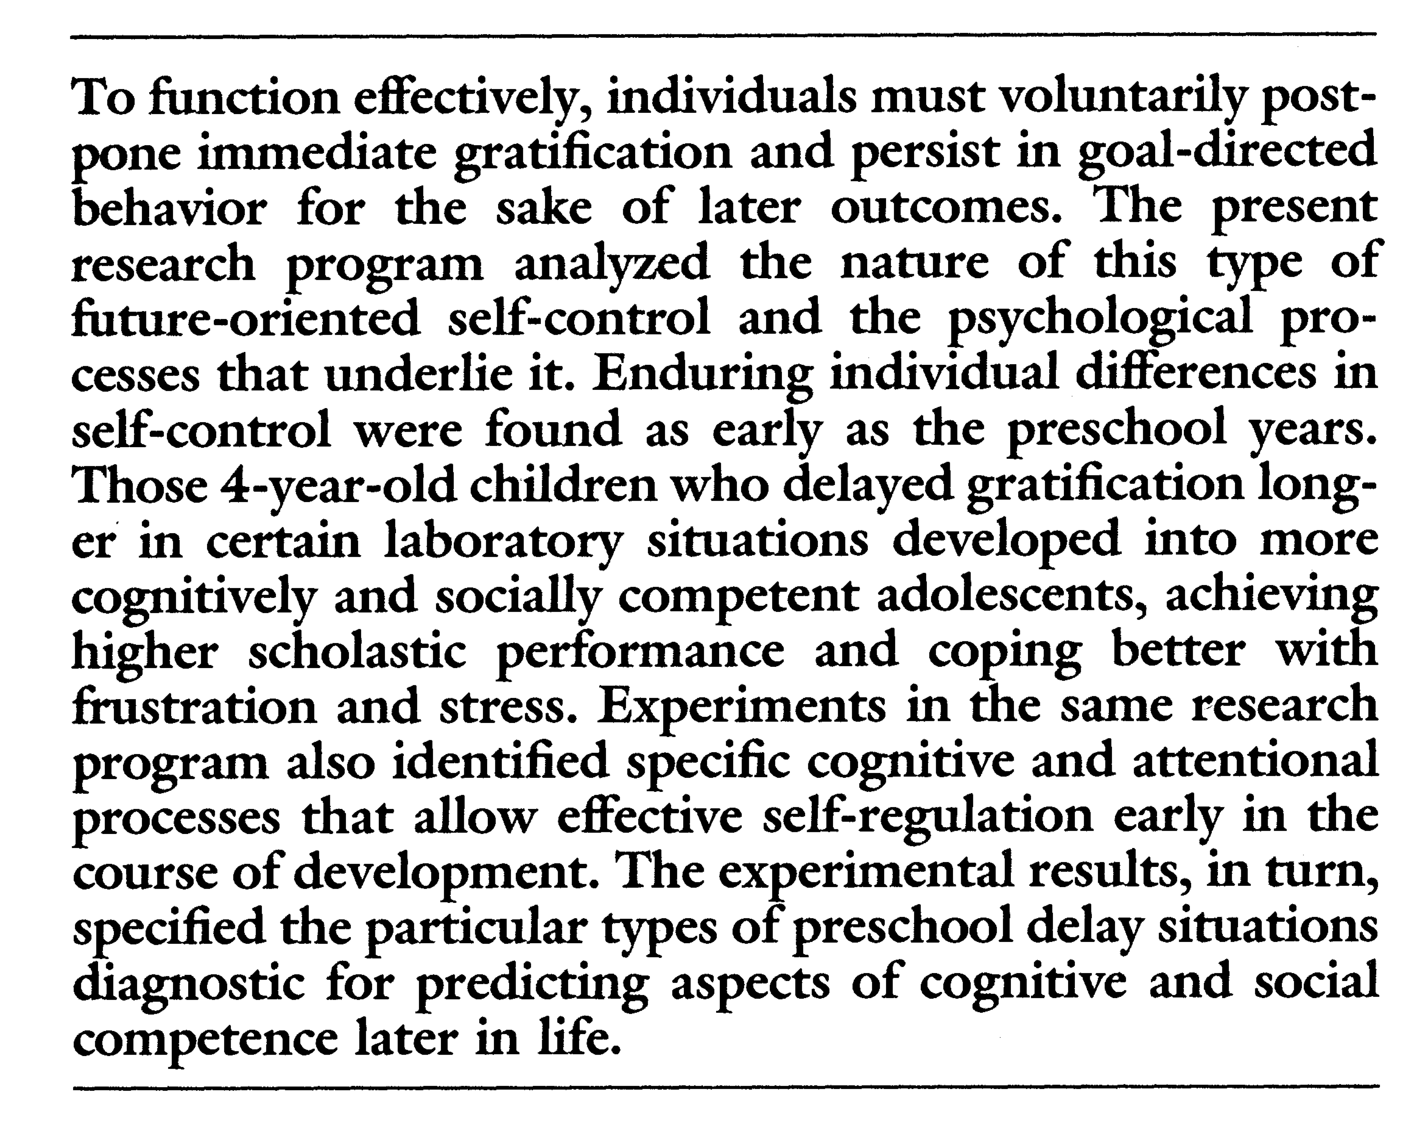
Mischel, shoda, & rodriguez (1989)

