Slide 1
Jeffrey Holmes and Geoff Turner
April 5, 2013

Slide 2
Cockroaches, Urinals, and Placebos:
Ten Cool Studies to Promote Student Appreciation for Research in Psychology
Jeffrey Holmes Geoff Turner
Ithaca College Simmons College
April 5, 2013

Slide 3
Middlemist, Knowles, & Matter (1976)

Slide 4
Zajonc, Heingartner, & Herman (1969)

Slide 5
Travers & milgram (1969)

Slide 6
Moseley et al. (2002)

Slide 7
Clark & Hatfield (1989)

Slide 8
MINAMI & DALLENBACH (1946)

Slide 9
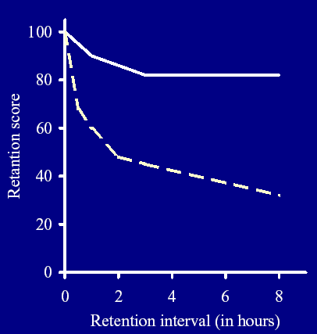
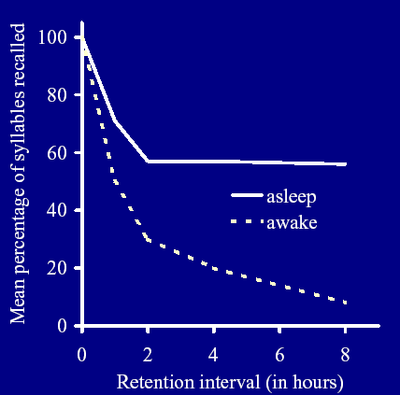
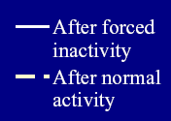
Cockroaches
College Students

Slide 10
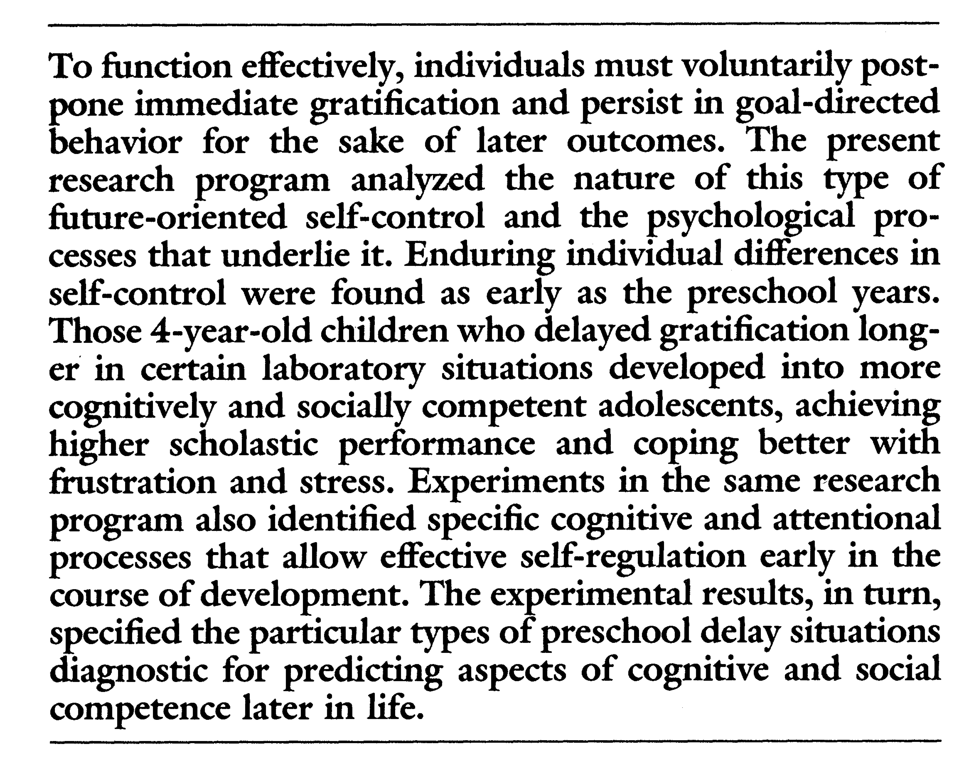
Mischel, shoda, & rodriguez (1989)

Slide 12
Simons & Levin (1998)

Slide 14
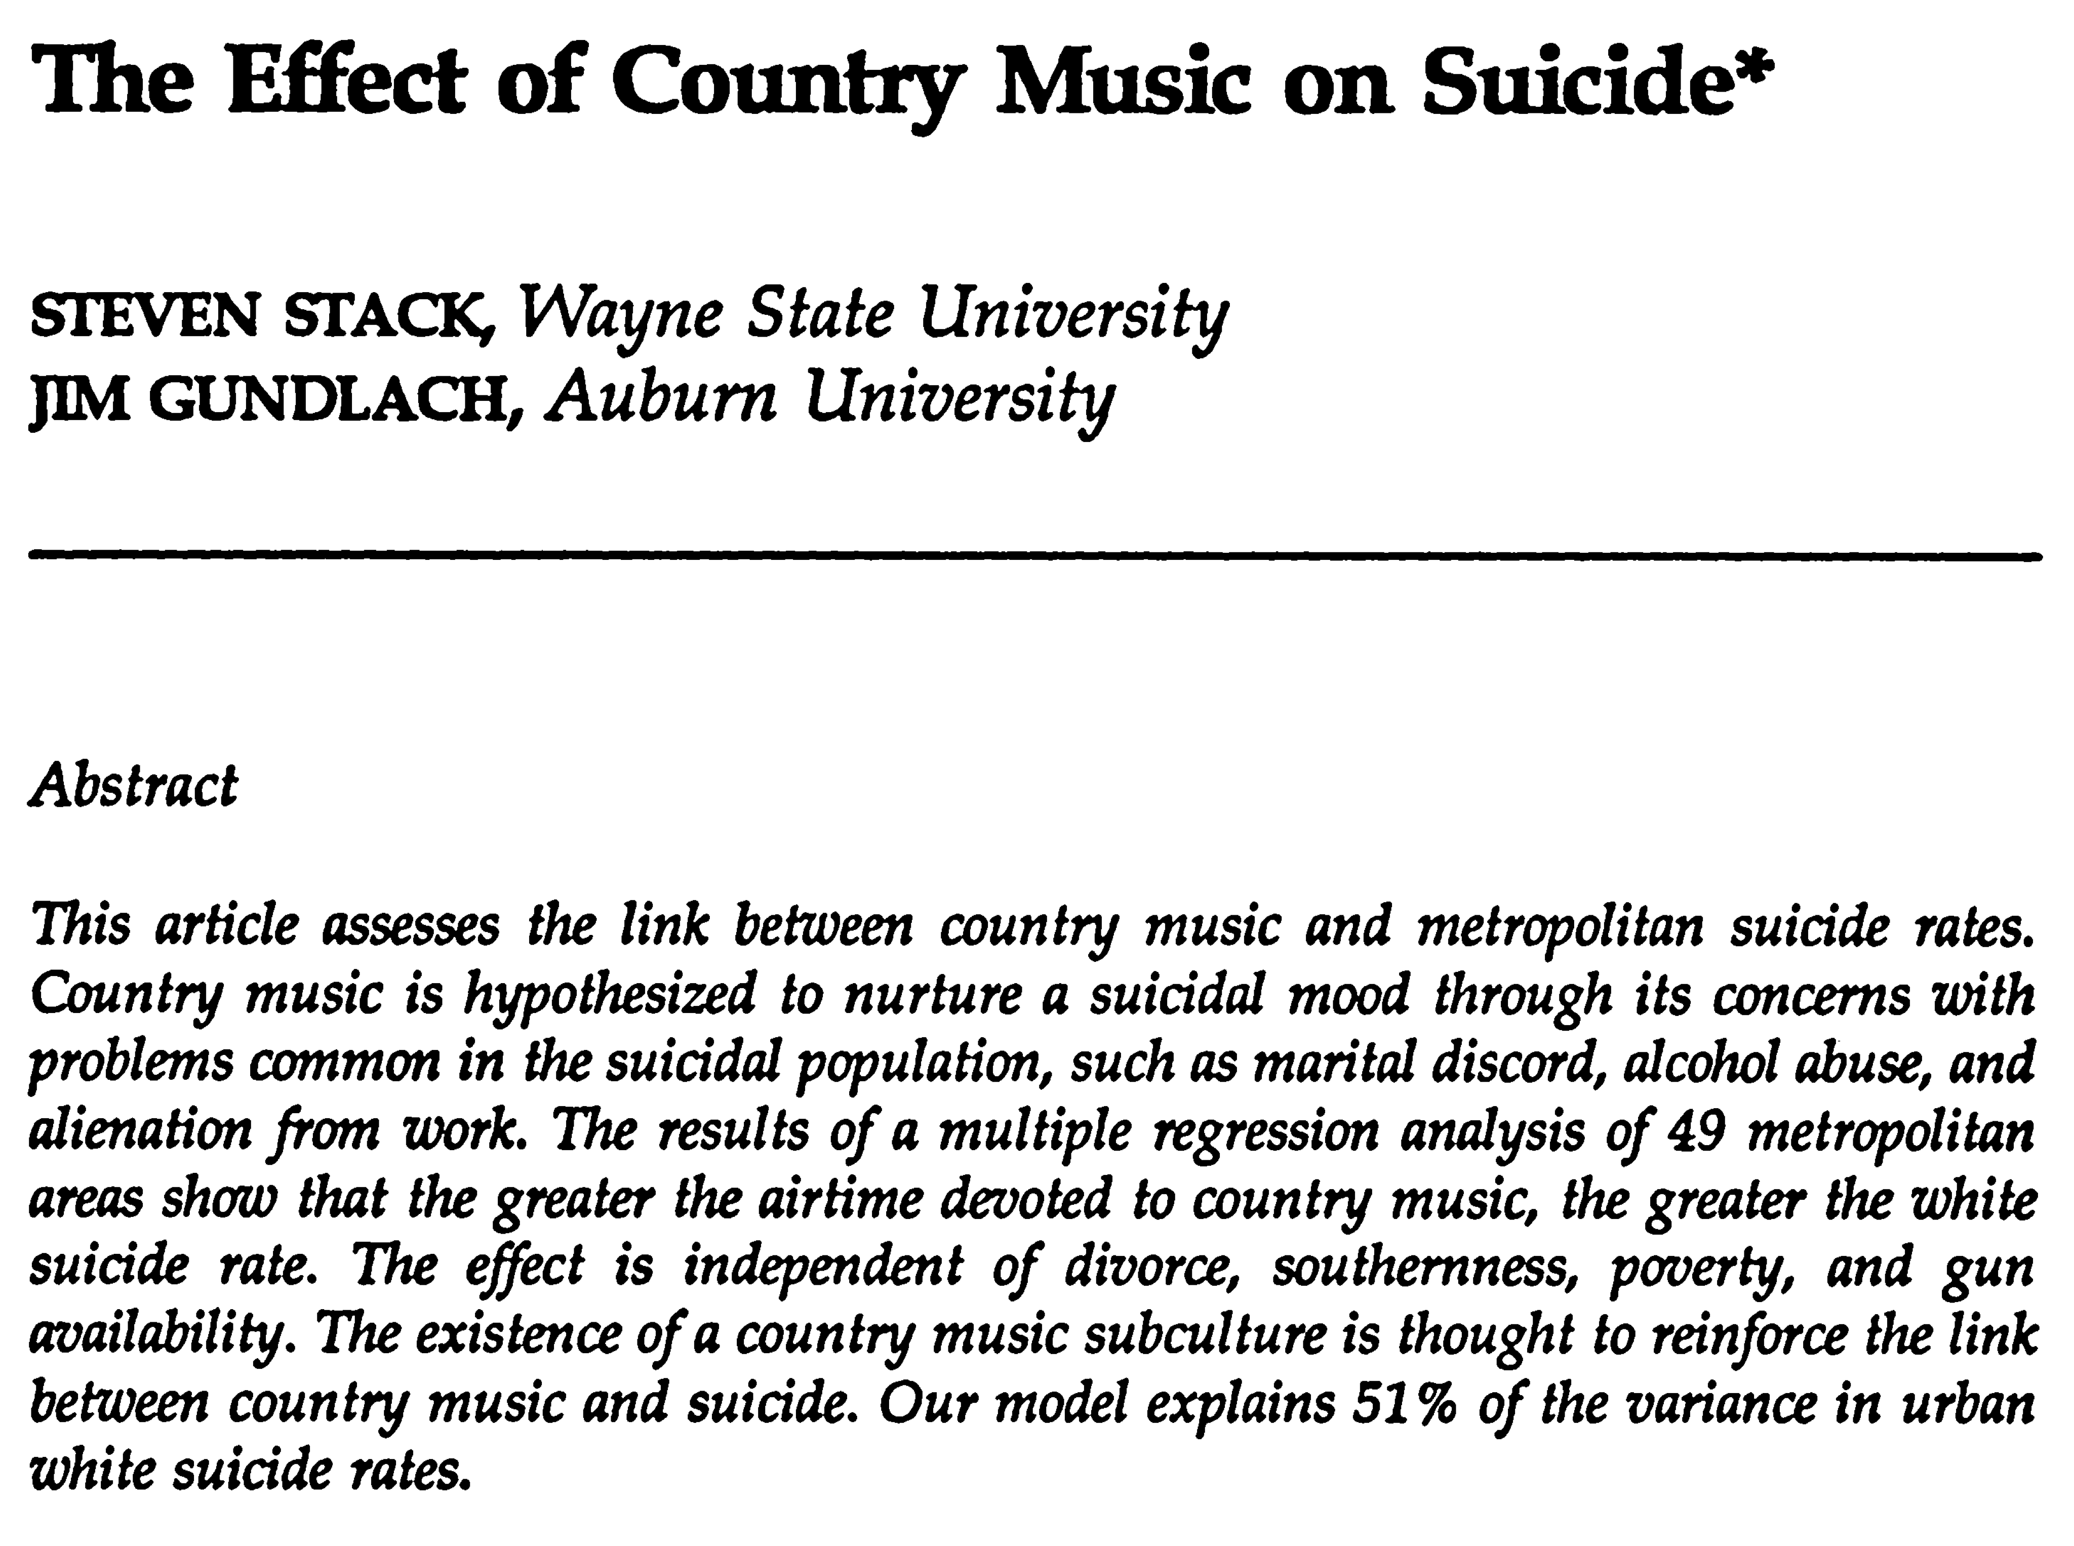
Stack & Gundlach (1992)
Notes:
George Jones – If Drinkin’ Don’t Kill Me Her Memory Will;
& A picture of me without you

Slide 15
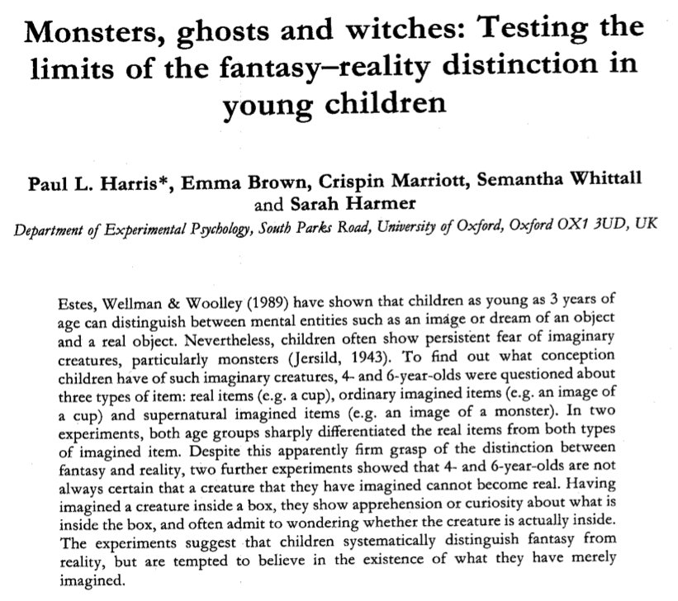
Harris, Brown, Marriott, Whittall, & Harmer (1991)

Slide 16
Thanks!
Questions?

