Slide 2
Using Google Forms to Collect Data and Present Results for In-class and Out-of-class Lab Projects
Geoff Turner
Simmons College

Slide 3
Why Use Google Forms?
Increases active learning opportunities
Labs without labs
Increases participation and motivation
Lower cost and greater versatility than “clickers”
Can be anonymous
Can record participation (names) as well as data
Quick (after set-up)
No unfamiliar or new software to buy, learn, or install
Response competition

Slide 4
Examples
Echolocation
Multitasking
Dichotic Listening
Weber’s Law
Conformity & Crowd Size
Alcohol Use
SRS vs Stratified Random Sample
Standard Error of the Mean

Slide 5
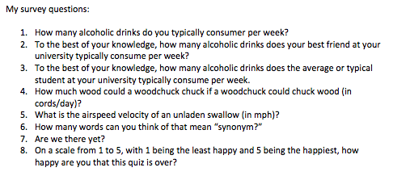
Create a set of questions

Slide 6
Create a set of charts in Excel

Slide 7
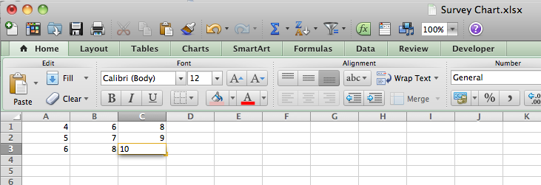
Place data in the first n columns

Slide 8
Create the statistics.

Slide 9
Create your chart or figure EXACTLY as you want it to appear in class.

Slide 10
Create a PowerPoint slide using “Paste Special”

Slide 11
Create a PowerPoint slide using “Paste Special”

Slide 12
Create a PowerPoint slide using “Paste Special”

Slide 13
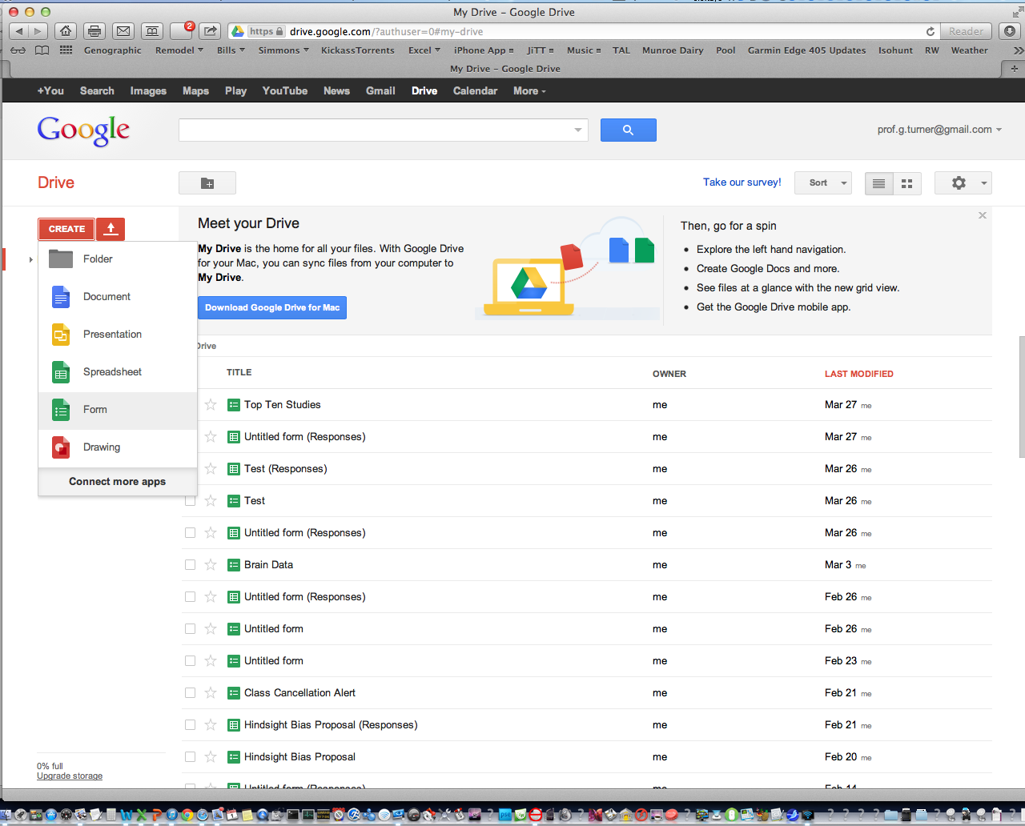
Create a form in Google Docs

Slide 14
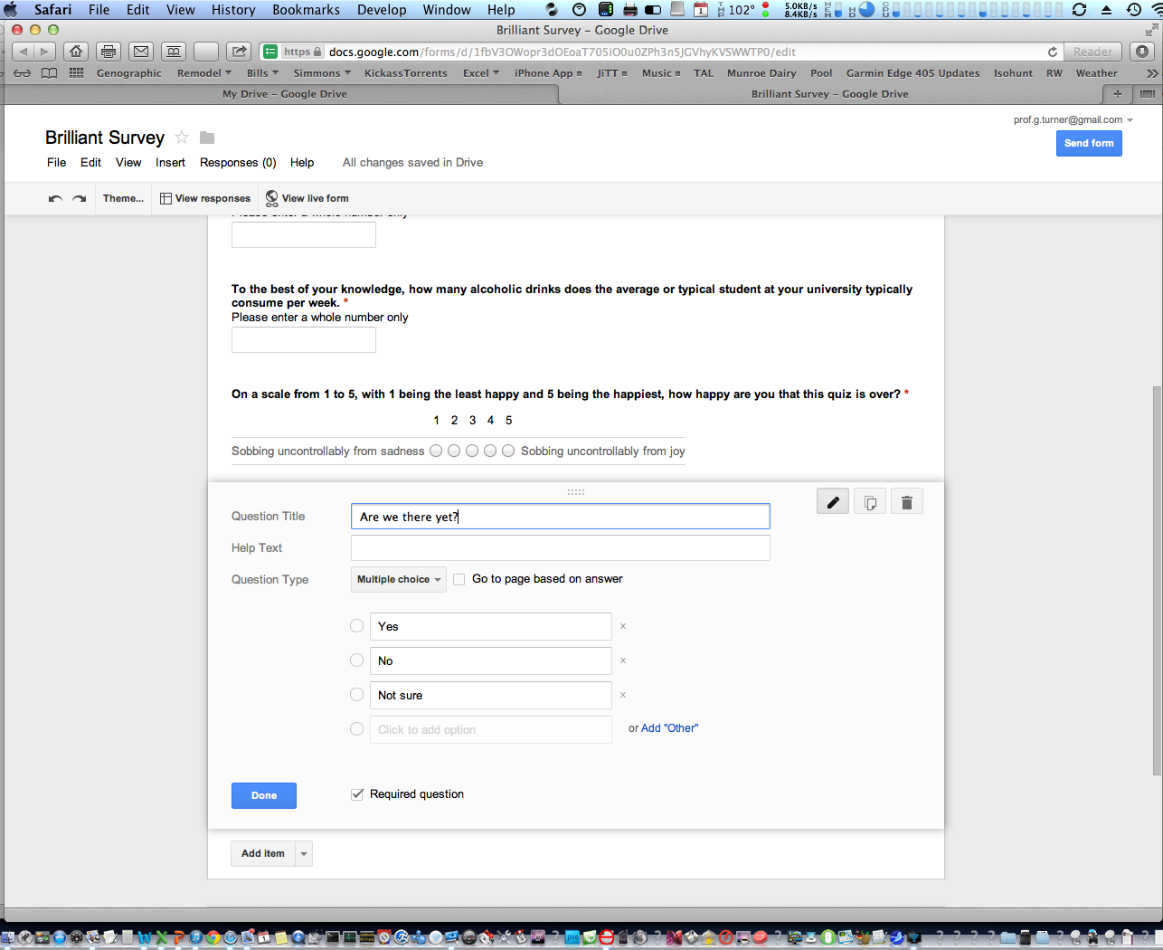
Create a form in Google Docs

Slide 15
Post a link to the Google form in your LMS or email the link to your class.
https://docs.google.com/forms/d/1fbV3OWopr3dOEoaT705iO0u0ZPh3n5JGVhyKVSWWTP0/viewform
vs
http://web.simmons.edu/~turnerg/TOP2013.html
vs
Click Here

Slide 16
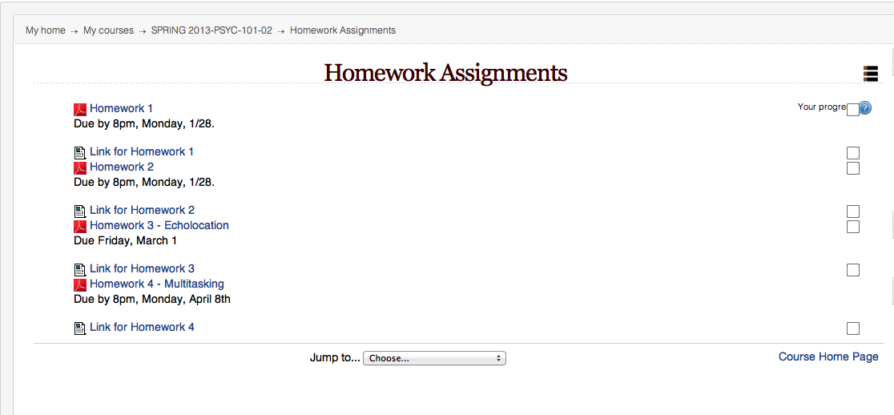
Post a link to the Google form in your LMS or email the link to your class.

Slide 17
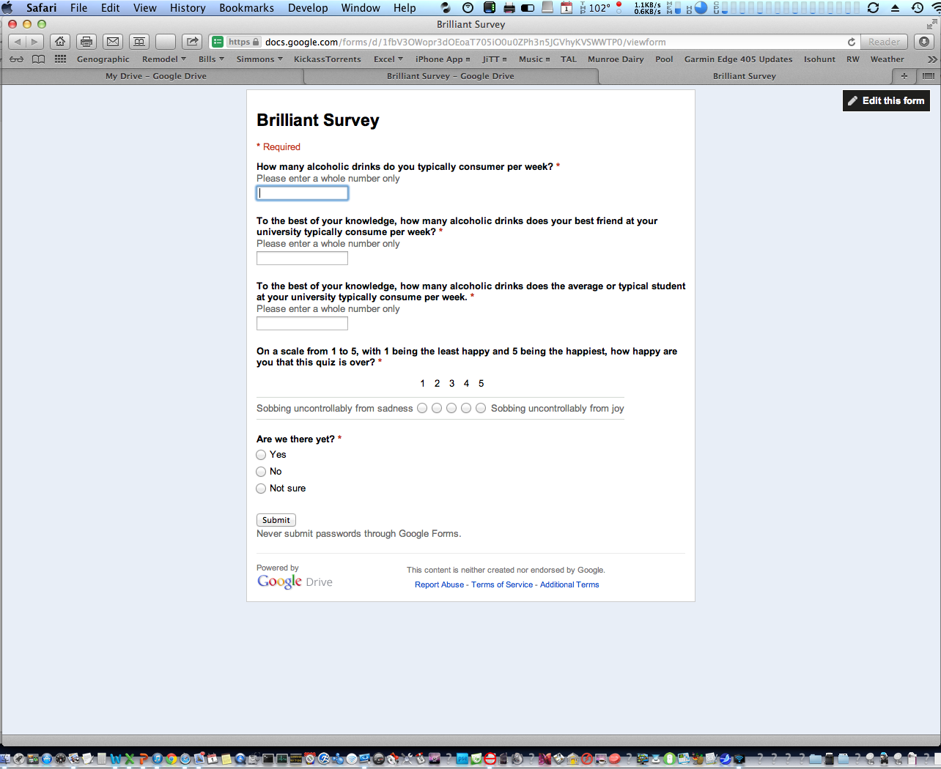
Collect your data

Slide 18
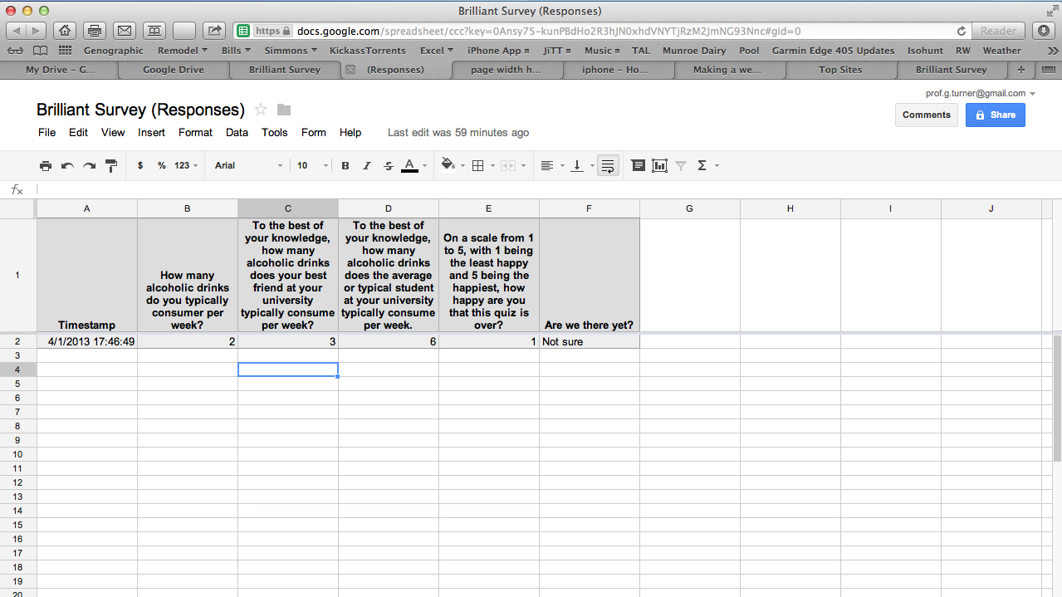
Collect your data…

Slide 19
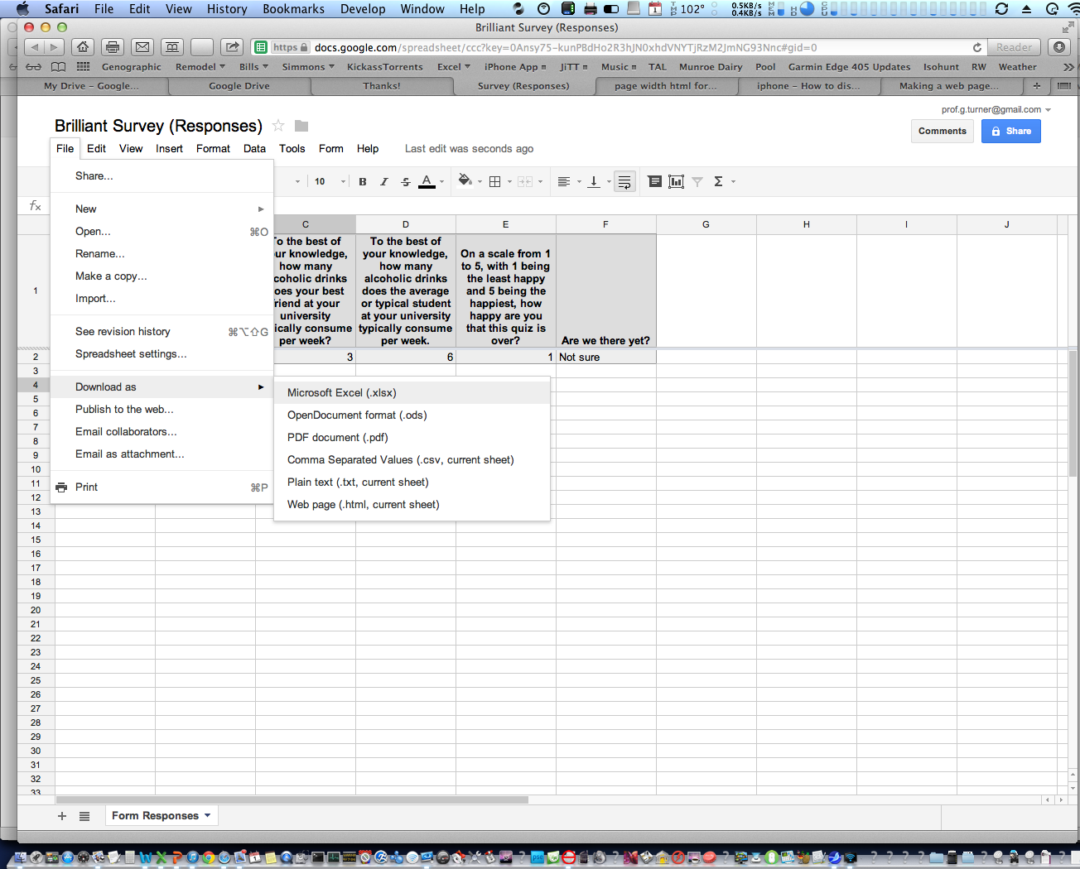
Open the downloaded .xlsx file and copy the data.

Slide 20
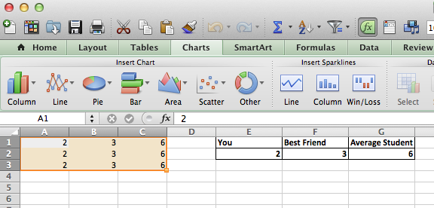
From PowerPoint, open the chart/figure and paste your data over the dummy data

Slide 21
Re-start your slideshow from the current slide.

Slide 22
Alcohol Use Survey

Slide 23
Bask in the “oohs” and “ahs” of an impressed and grateful student body.
Questions?

Slide 24
Free Downloads!
http://web.simmons.edu/~turnerg/TOP2013
This PowerPoint
The Excel Spreadsheet
The handout

