Slide 1
Sweets, Shock, Bowling, and Psychopaths:
Bringing nine counterintuitive findings in psychology into the classroom. Why what you know from your experience is just plain wrong.
Geoff Turner Jeffrey Holmes David Bennett
Simmons College Ithaca College North Park University
April 4, 2014

Slide 2
It’s the little things

Slide 3
Stress

Slide 4
Daily Hassles & Uplifts
r = 0.17
r = -0.03
r = 0.60
r = 0.53
Major Life Events
r = 0.21
r =ns, not reported
Psychological Well-being
Partial correlations showed that DHU completely subsumed effects due to MLF.
  Stepwise regression with DHU first shows no link between MLE and Well-being.
  Stepwise regression with MLE first shows significant remaining effect for DHU.

Slide 5
Diet Soda Makes You Fat
Sort of

Slide 6
The Diet Industry Logic – Common Sense
Weight loss requires a reduction in calories.
Low-calorie diet foods and beverages have fewer calories than high calorie non-diet foods.
Therefore:
Replacing high-calorie foods with low-calorie diet foods will lead to weight loss.
The idea that diet foods could cause weight gain is clearly nonsensical; a physiological impossibility.
Notes:
Normally, sweet taste predicts nutrative ingestion*
Eating non-nutrative sweeteners weakens the link between sweet tastes and calories.

Slide 7
Why the ‘common-sense’ model is wrong
Salivation
Stomach Motility
Hunger
Sweet Taste + Calories
Sweet Taste.
Notes:
Taste and odor cues have several effects
increase salivation
increase hunger
increase stomach motility
Effects such as these are classically conditioned. Taste and odor cues serve as conditioned stimuli that elicit several postingestive conditioned responses.

Slide 8
Experiment 1
Exposure
Training
Testing
Kool-aid with 10% polycose
Kool-aid with 10% glucose
Two bottles: Kool-aid with either polycose or glucose –
consistent vs. inconsistent with sweet taste.
Saccharin Solution Group
Water Group
Kool-aid with 10% polycose
Kool-aid with 10% glucose

Slide 9
Experiment 1
Exposure
Training
Testing
Saccharin Solution Group (30 ml/day) – hypothesized to reduce the taste-calorie association.
Water Group (30 ml/day) – hypothesized to maintain the taste-calorie association.
Grape or cherry (counterbalanced) Kool-aid (30 ml/day) – with 10% polycose
Grape or cherry (counterbalanced) Kool-aid (30 ml/day) – with 10% glucose
Two bottles: 30 ml of grape flavored Kool-aid & 30 ml of cherry flavored Kool-aid with either polycose or glucose – consistent vs. inconsistent with sweet taste.
Grape or cherry (counterbalanced) Kool-aid (30 ml/day) – with 10% polycose
Grape or cherry (counterbalanced) Kool-aid (30 ml/day) – with 10% glucose

Slide 10
Results
Notes:
After 4 hrs, bottles weighed.
intake of glucose-paired flavor higher for rats exposed to saccharin than those given only water
intake of glucose-paired flavor no higher for rats exposed to polycose b/c polycose is caloric but not sweet.
Conclusion: rats ate more sugar – but not fewer calories (b/c they felt less full) when sweet was paired with non-caloric drink. Sweetness no longer causes the same feedback – no longer signals calorie arrival (via classical conditioning).

Slide 11
You are studying too much.

Slide 12



SSSS
SSST
STTT
Which group will remember
the most a week later?

Slide 13
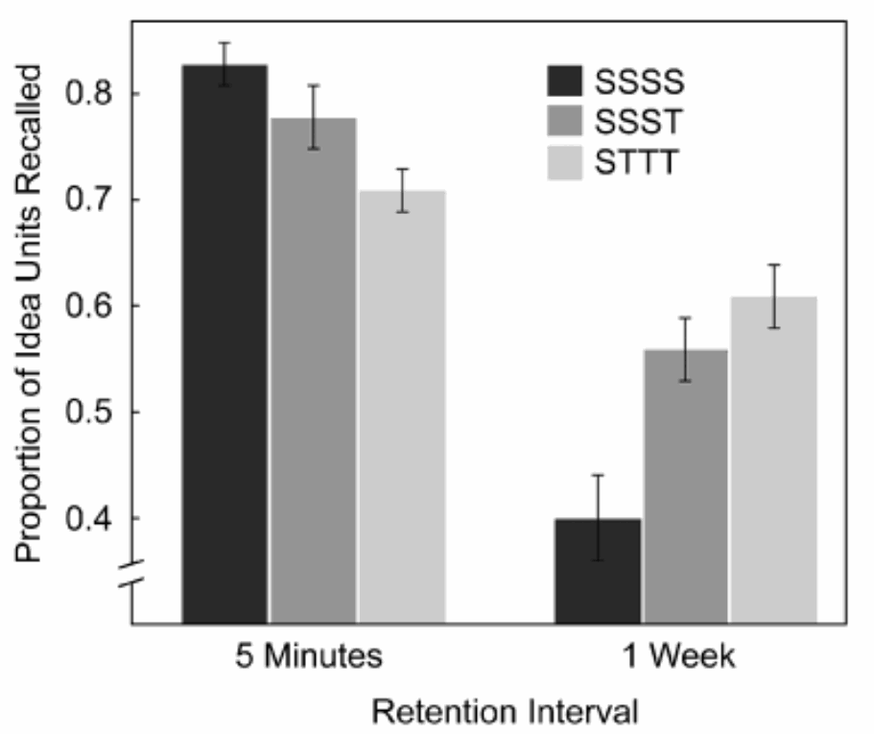
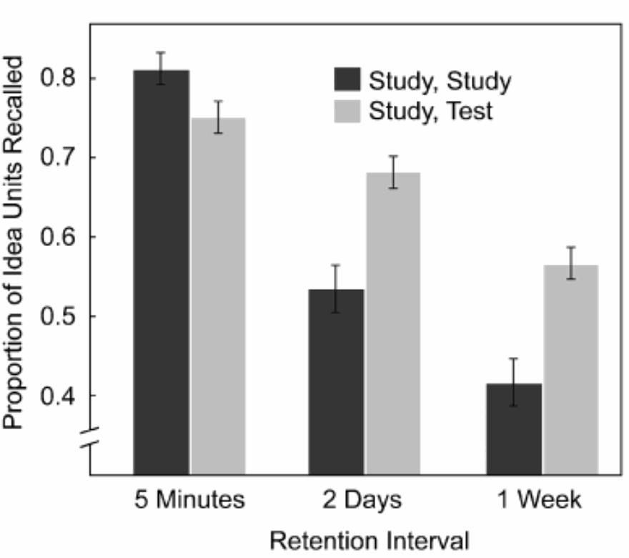
Test More, Study Less
This gives us the FALSE sense that studying works.
Karpicke & Roediger (2008)

Slide 14
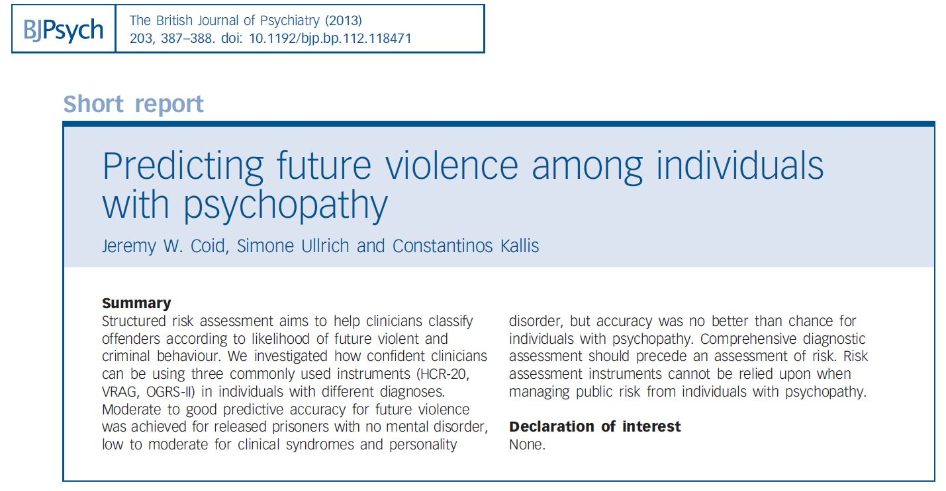
Coid et al. (2013)

Slide 15
Coid et al. (2013)
Method
  structured interviews with 1224 male prisoners
  assess risk of future violent behavior
  conviction for violent crime within 3 years
Results/Discussion
  no instrument predicted better than chance
  good at lying and manipulating?
  tests not sensitive enough?
Utility for Teaching
  difficult to predict what anyone will do

Slide 16
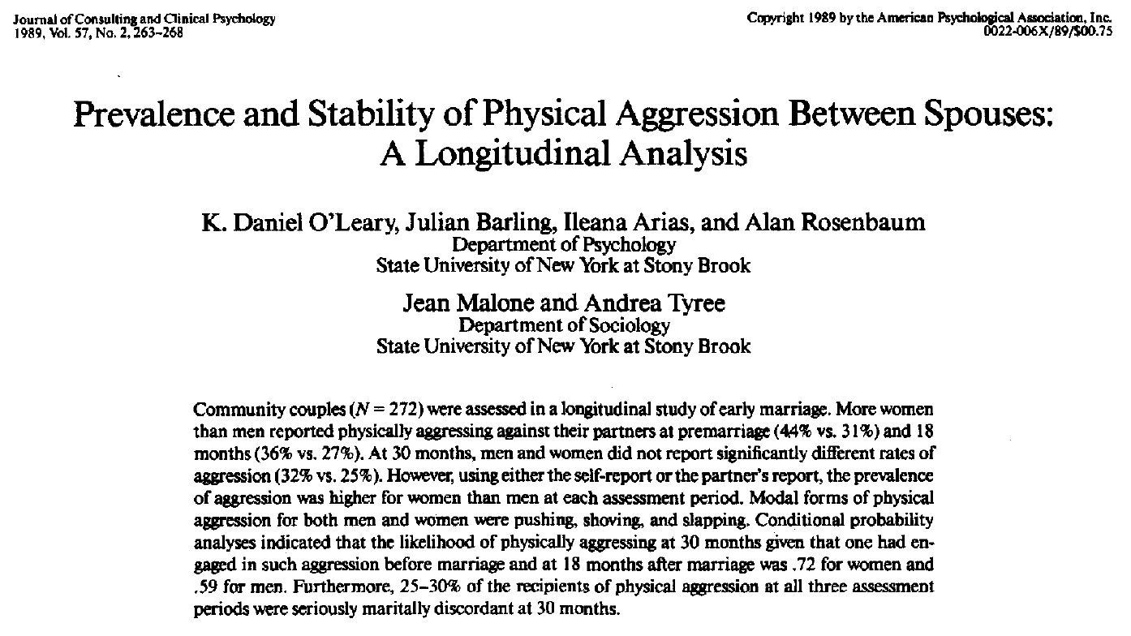
O’Leary et al. (1989)

Slide 17
O’Leary et al. (1989)
Method
  longitudinal study of 272 couples
  self-report aggression within past year
  assessed just prior to marriage; 18 and 30 months after marriage
Results/Discussion
  all 3 points in time – women reported more frequent aggression (sig. at premarriage and 18 months)
  tested for possible underreporting
  differences in potential consequences
Utility for Teaching
  contradicts stereotypes about behavior

Slide 18
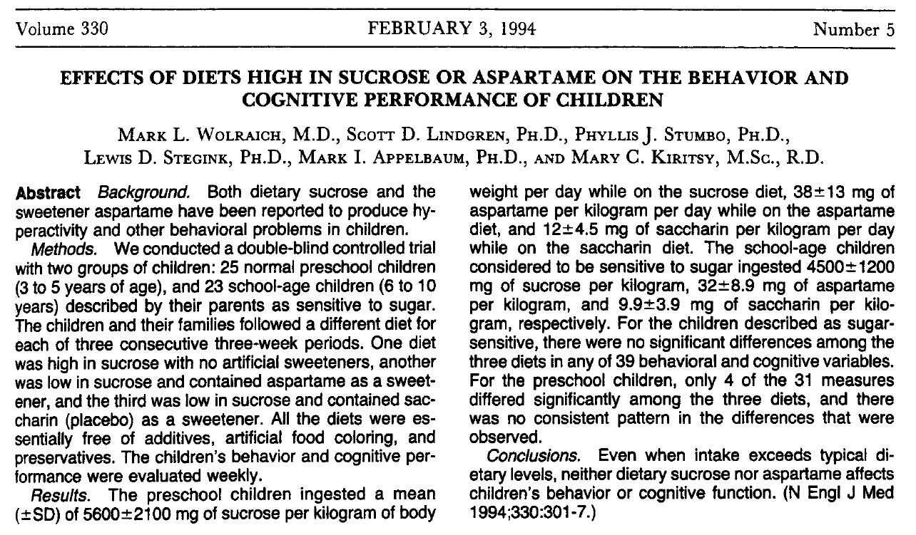
Wolraich et al. (1994)

Slide 19
Wolraich et al. (1994)
Method
  kids age 3-10 – parents say “sensitive to sugar”
  alternated 3 week diets (sugar, aspartame, saccharin)
  lots of cognitive and behavioral tests
  structured behavioral ratings by parents, teachers, and research assistants
Results
  school age kids – no effects on any of 39 variables
  preschool – sig. differences on 2 of 31 variables (but not as expected)
  “no child had an adverse response”
Utility for Teaching
  contradicts what everyone “knows”
  evidence from research vs. intuition
  discussion of confirmation bias

Slide 20
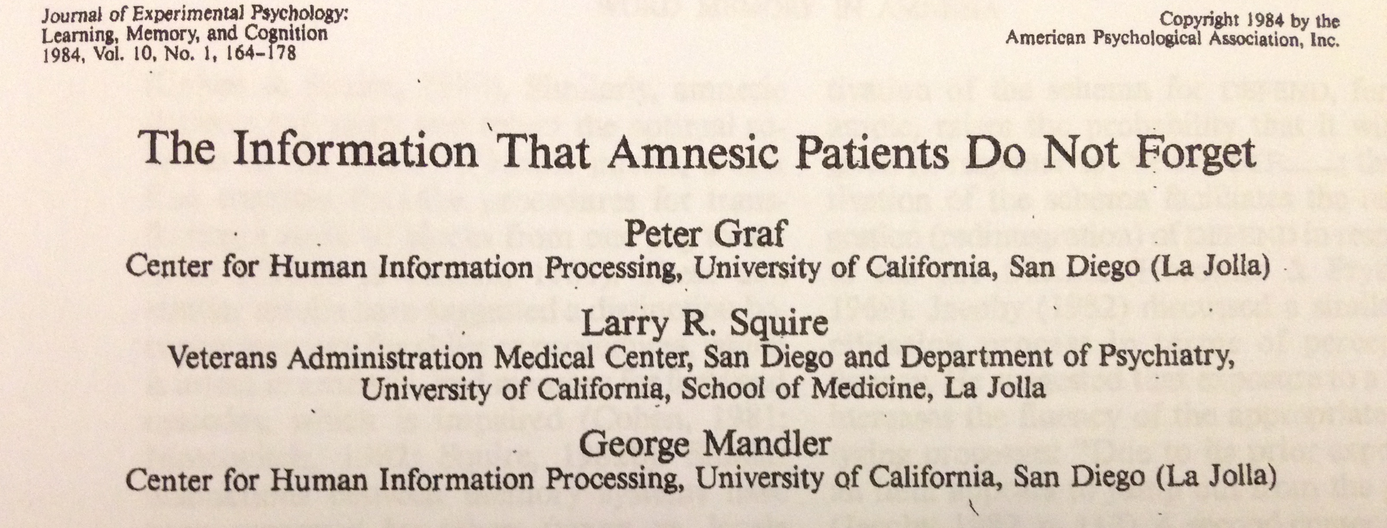
You don’t remember? Really?

Slide 21
You don’t remember? Really?
Recall
Recognition
Completion
Direct vs. Indirect testing

Slide 22
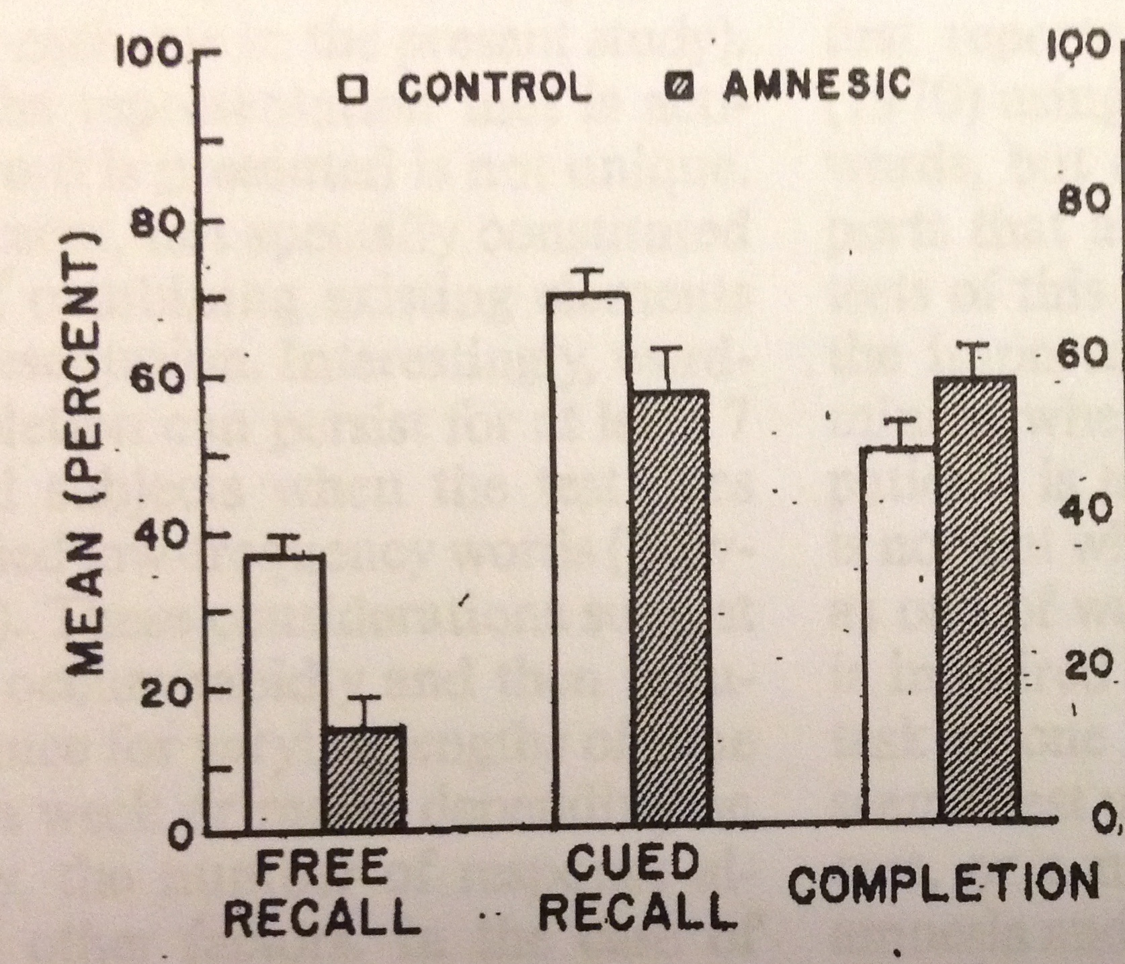
Amnesics show impairment in Fr Rc and Cued Rc but not in Completion.

Slide 23
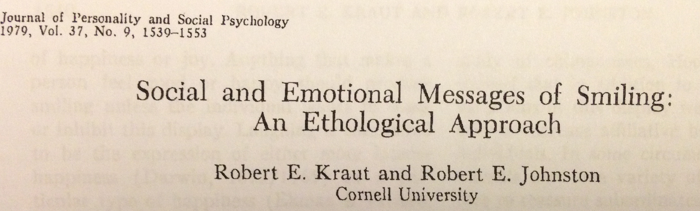
Strike a smile . . . NOW!

Slide 24


Slide 25
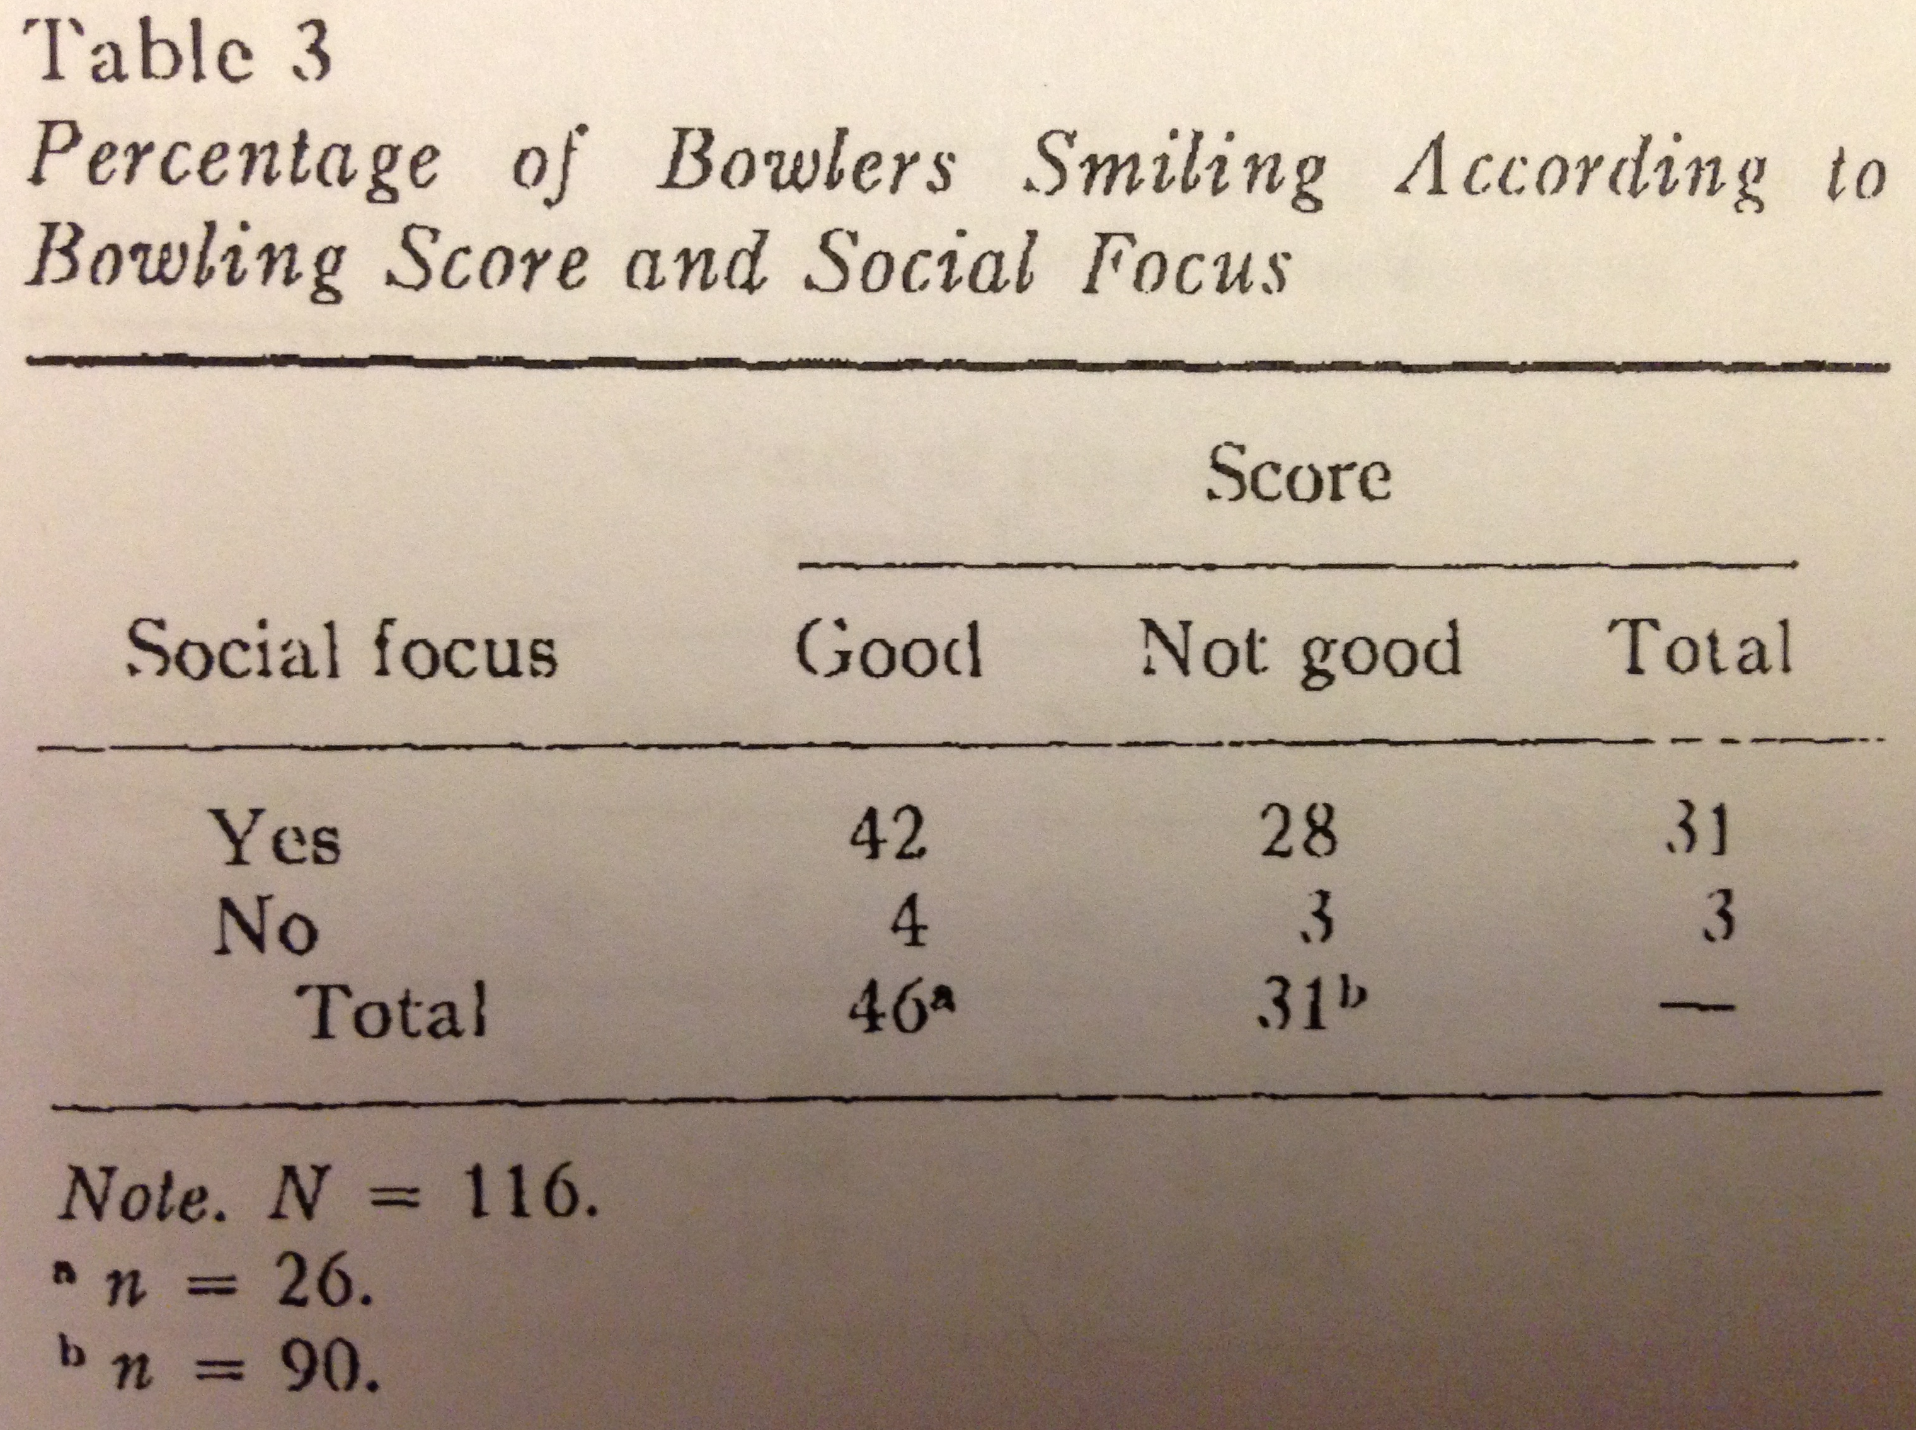
Bowling pins don’t [usually] smile back.

Slide 26
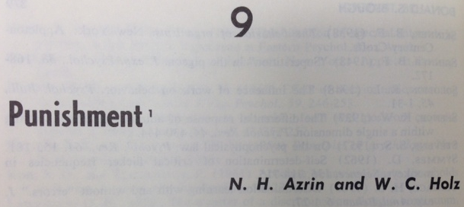
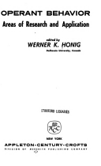
Don’t hold back!
IN

Slide 27
Don’t hold back!
Habituation
Punishment

Slide 28
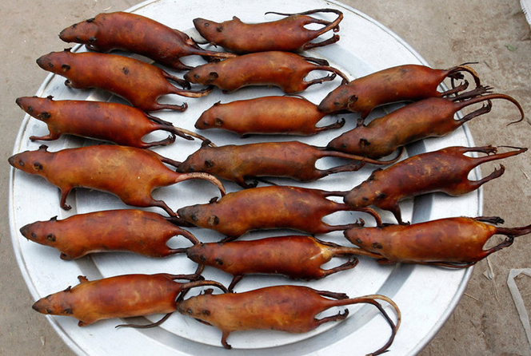
Worst case . . .

Slide 29
Thanks!
Questions?

