Slide 1
The Picture Study

Slide 2
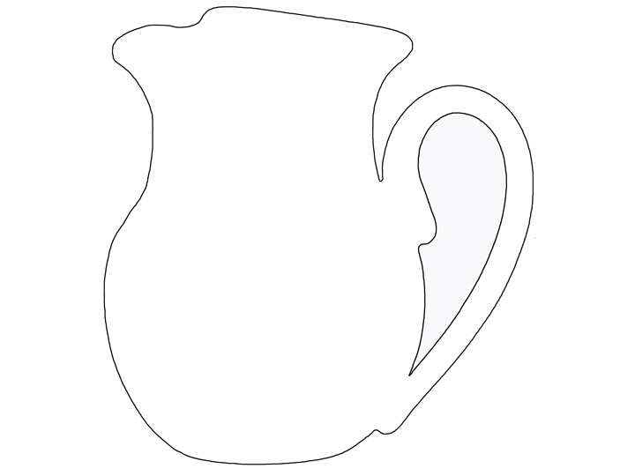
pitcher

Slide 3
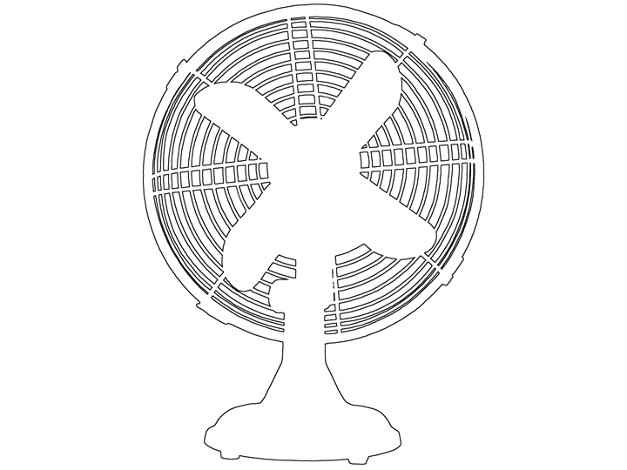
fan (electric)

Slide 4
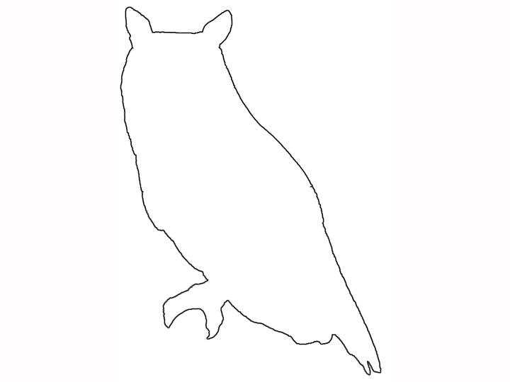
owl

Slide 5
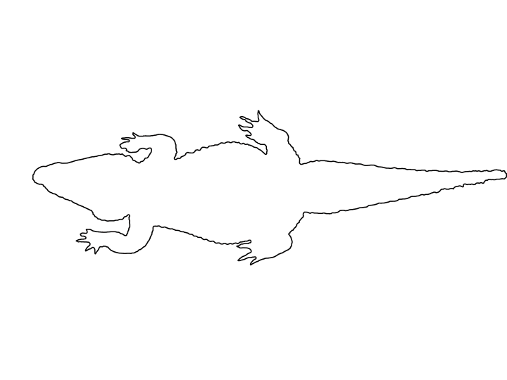
crocodile

Slide 6
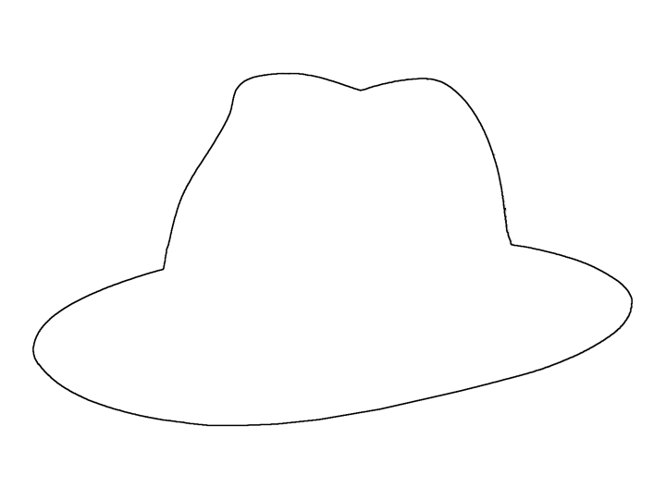
hat

Slide 7
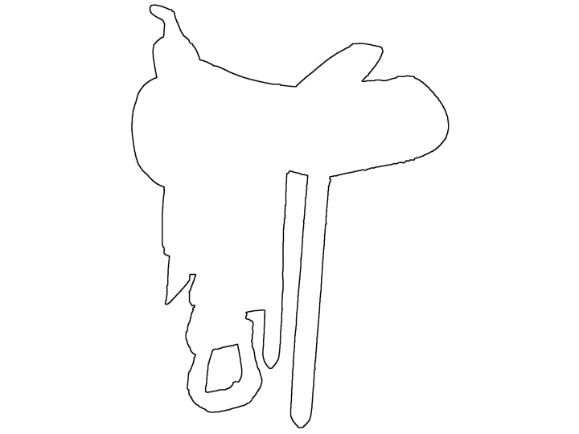
saddle

Slide 8
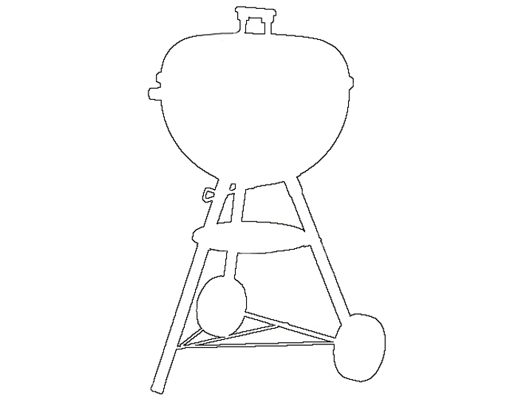
grill

Slide 9
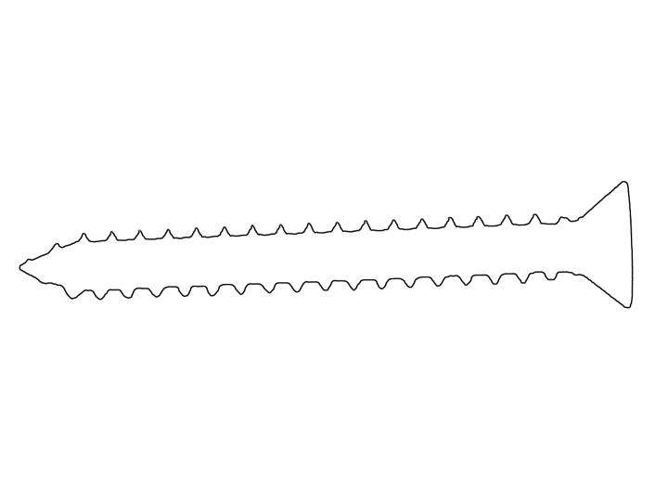
screw

Slide 10
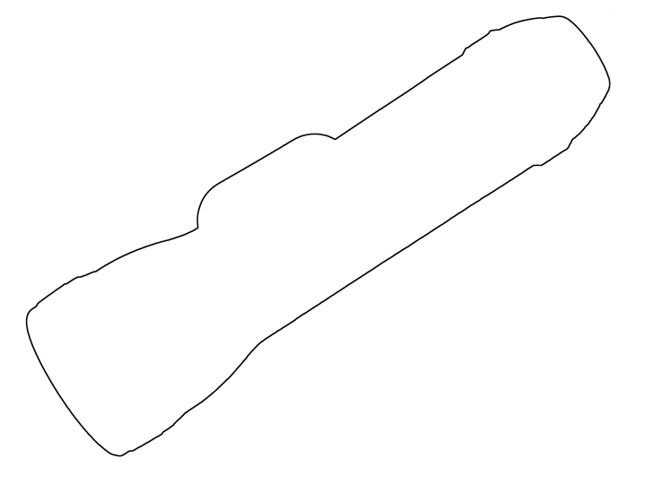
flashlight

Slide 11
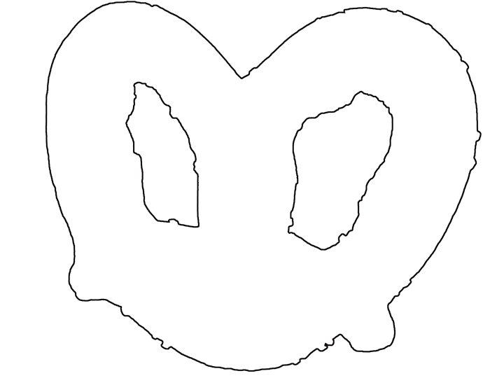
pretzel

Slide 12
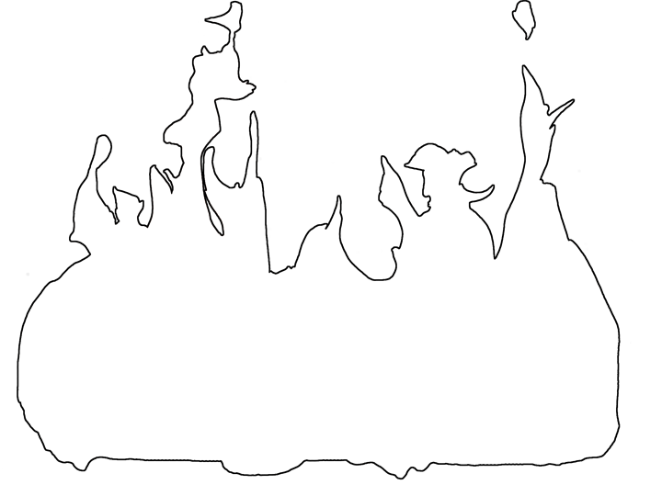
fire

Slide 13
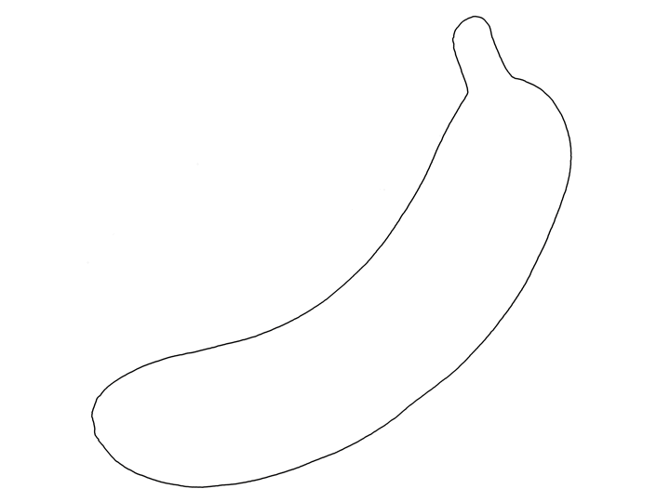
banana

Slide 14
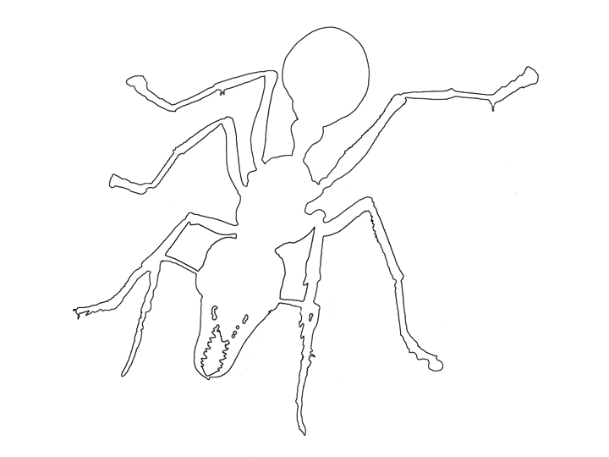
ant

Slide 15
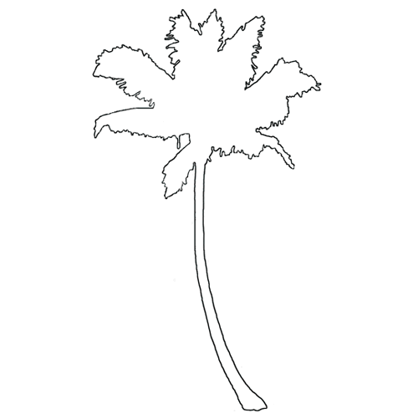
palm tree

Slide 16
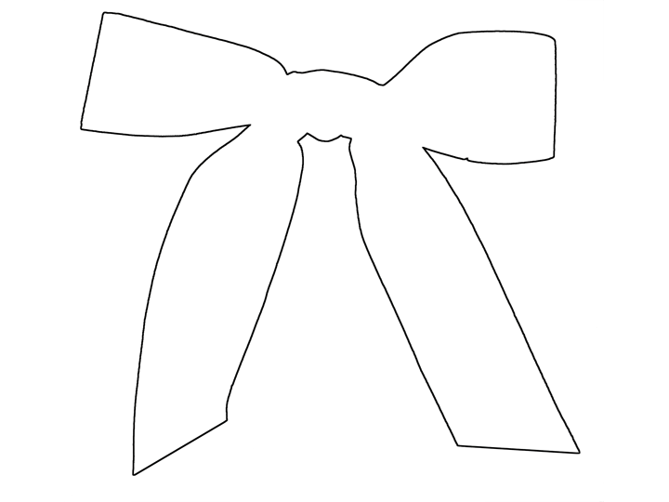
bow (ribbon)

Slide 17
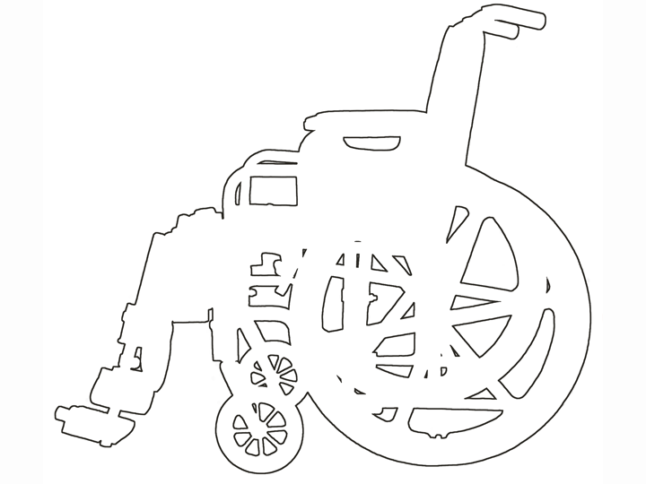
wheelchair

Slide 18
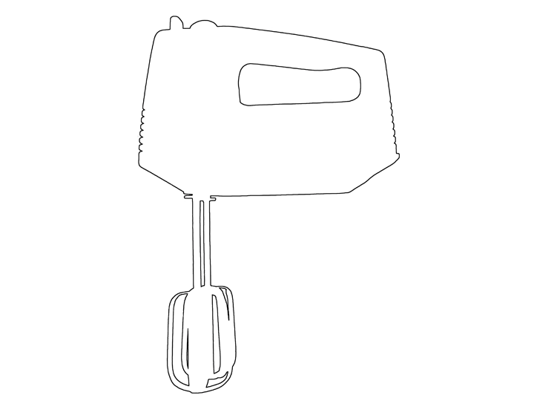
hand mixer

Slide 19
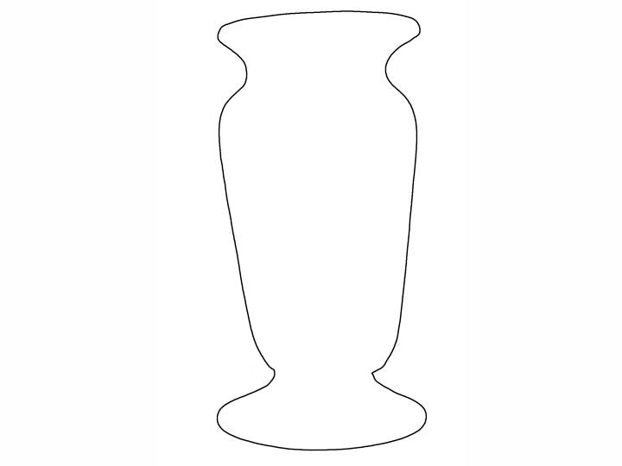
vase

Slide 20
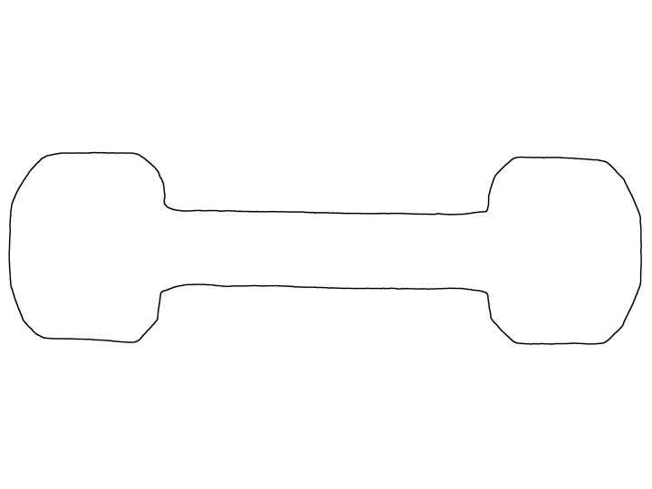
dumbbell

Slide 21
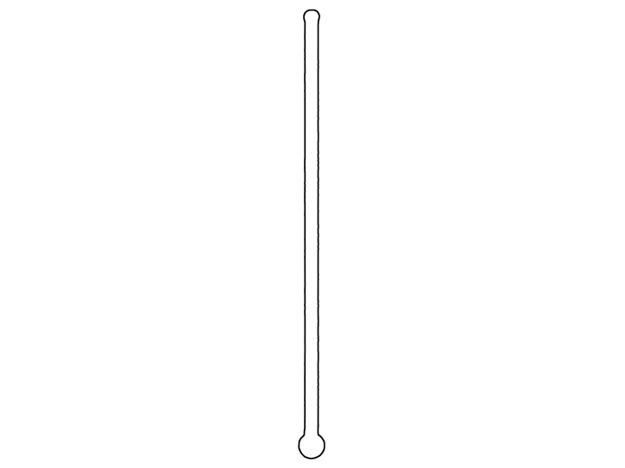
thermometer

Slide 22
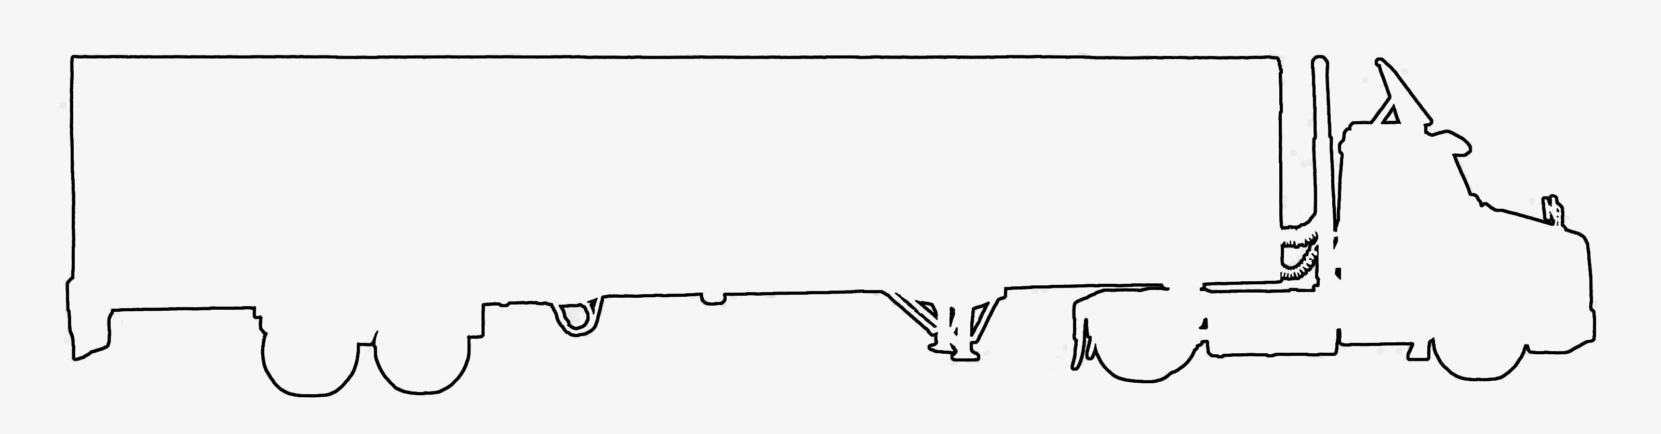
wagon

Slide 23
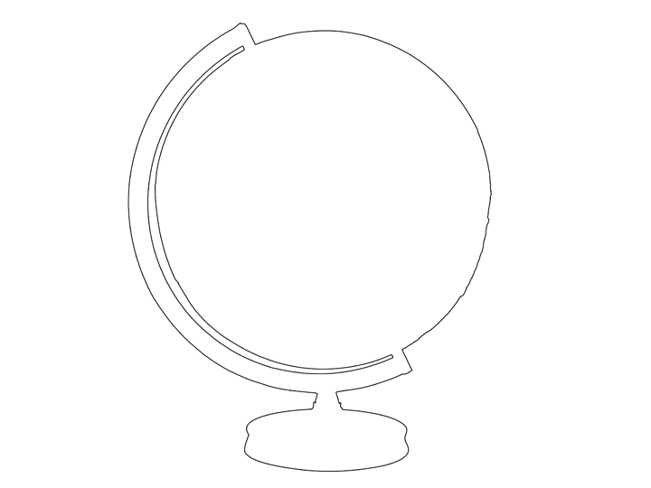
globe

Slide 24
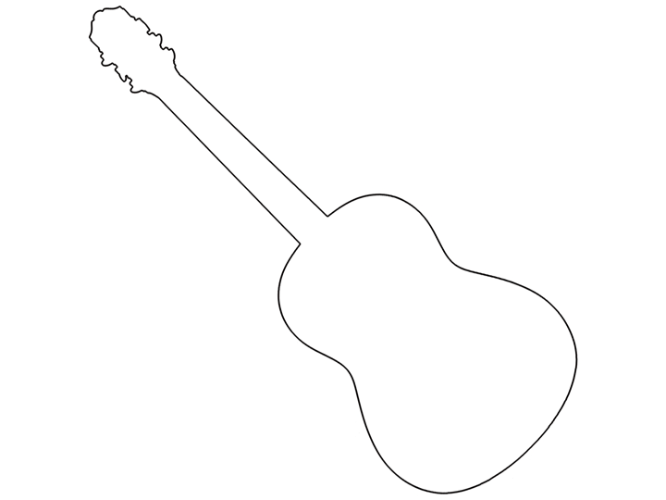
guitar

Slide 25
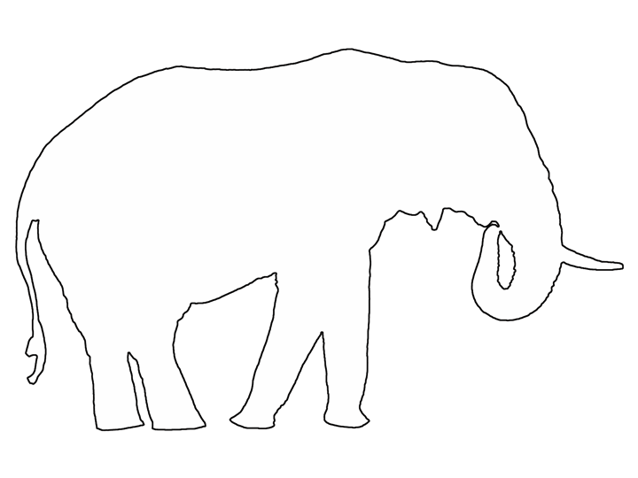
elephant

Slide 26
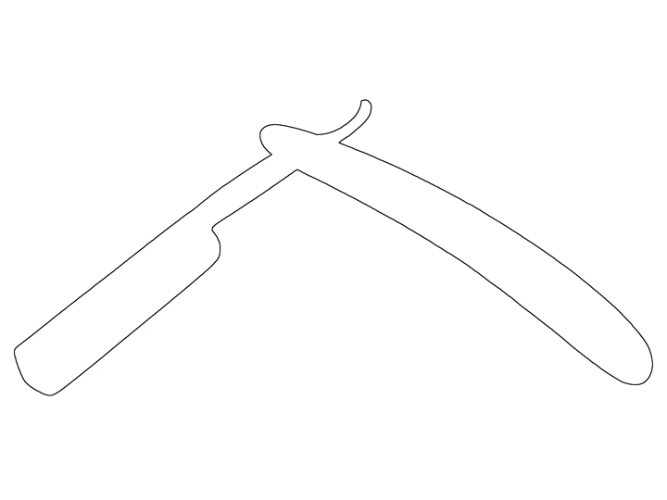
straight razor

Slide 27
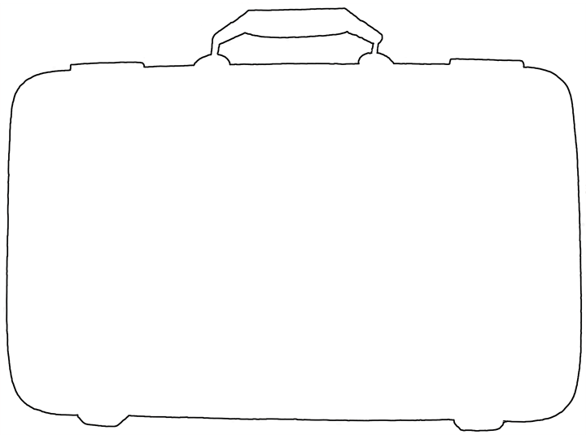
suitcase

Slide 28
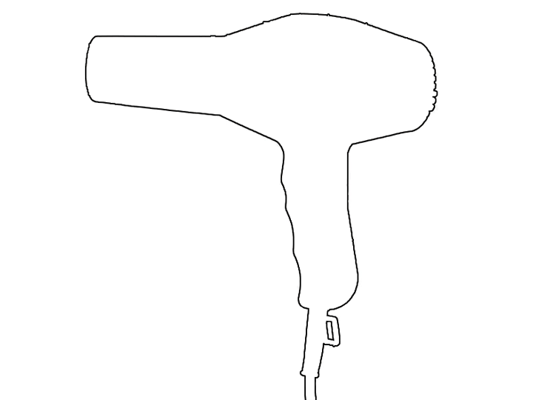
hair dryer

Slide 29

padlock

Slide 30
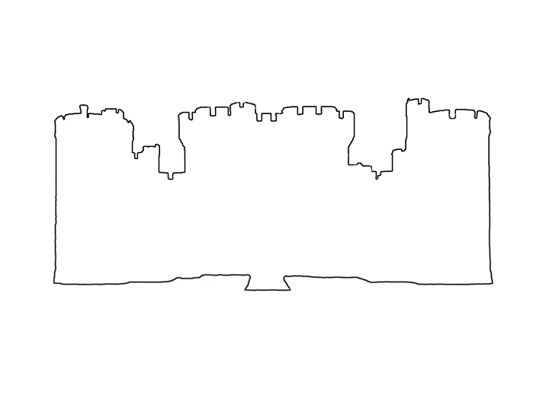
castle

Slide 31
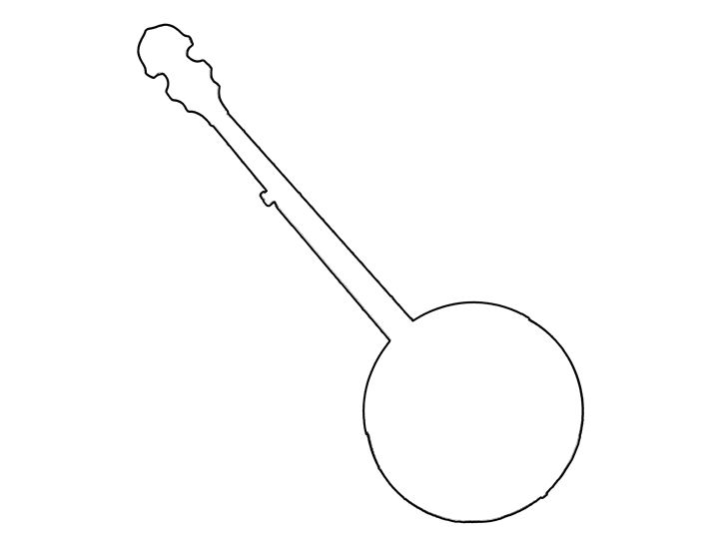
banjo

Slide 32
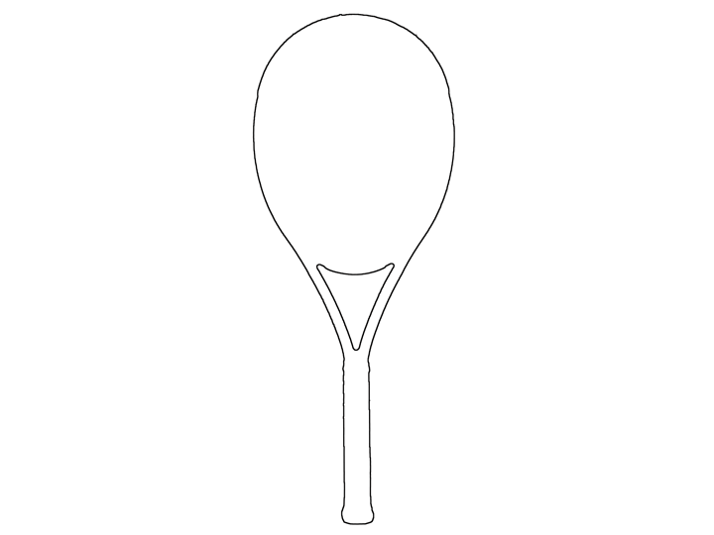
tennis racquet

Slide 33
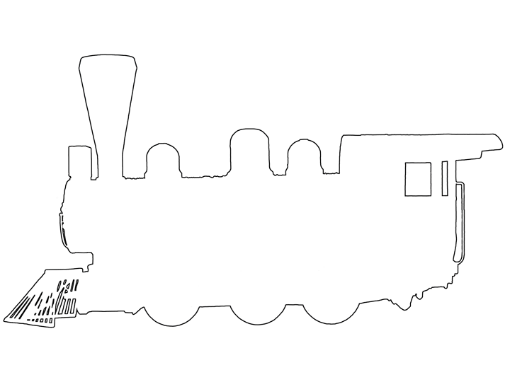
train

Slide 34
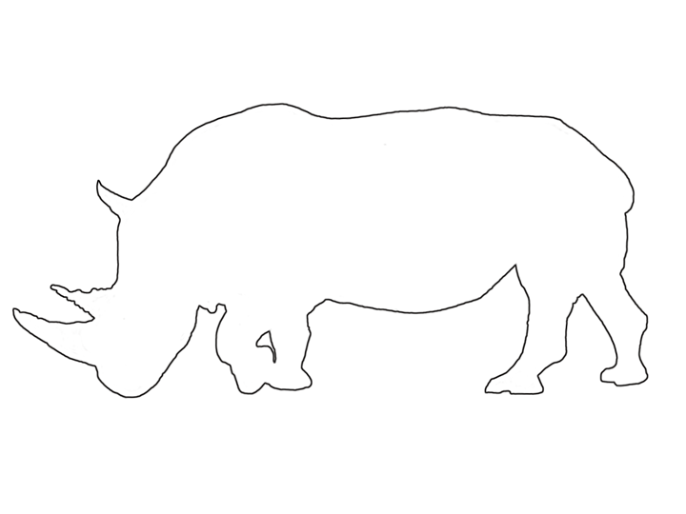
rhino

Slide 35
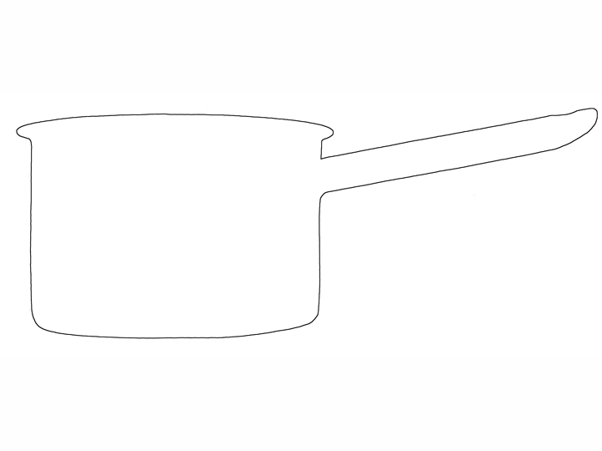
pot

Slide 36
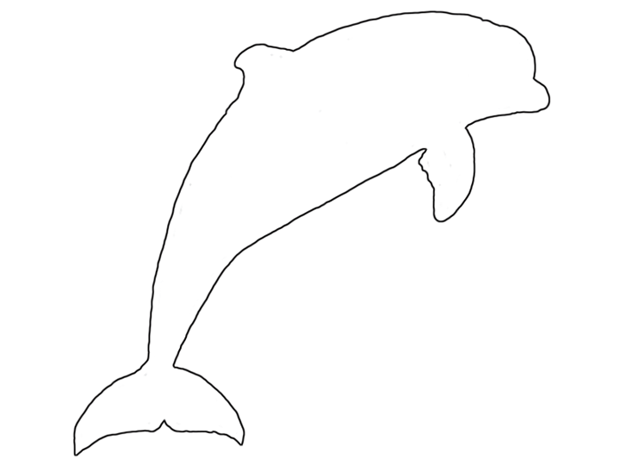
dolphin

Slide 37
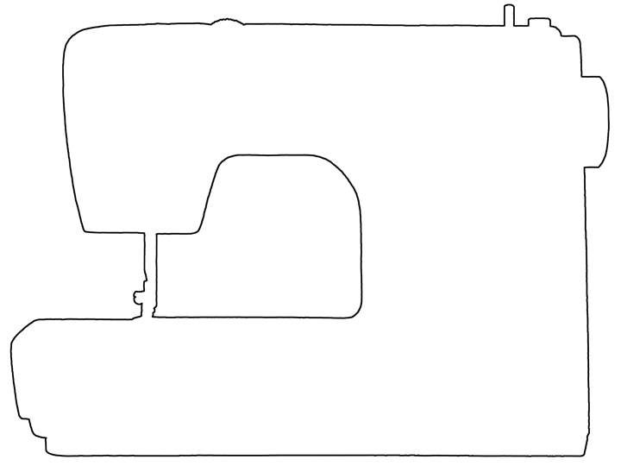
sewing machine

Slide 38
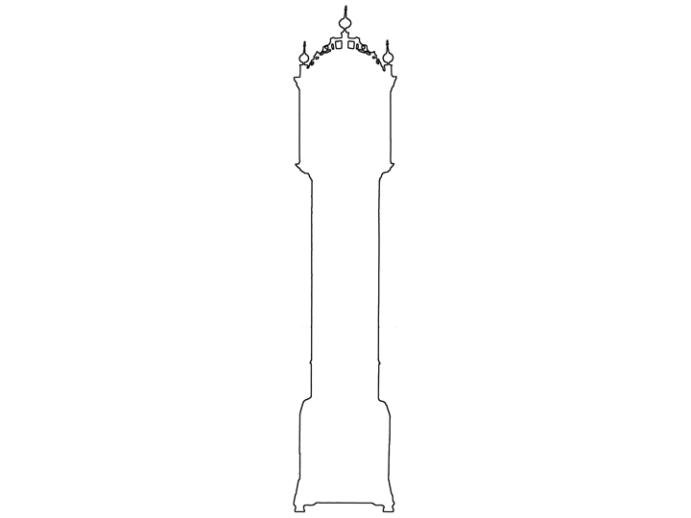
grandfather clock

Slide 39
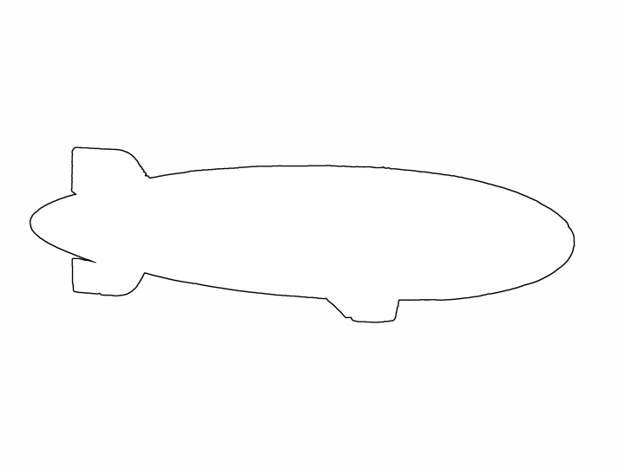
blimp

Slide 40
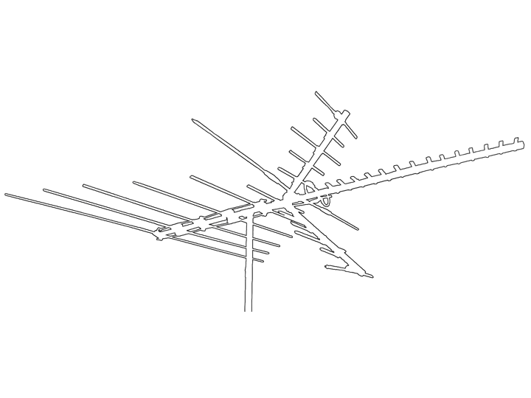
antenna

Slide 41
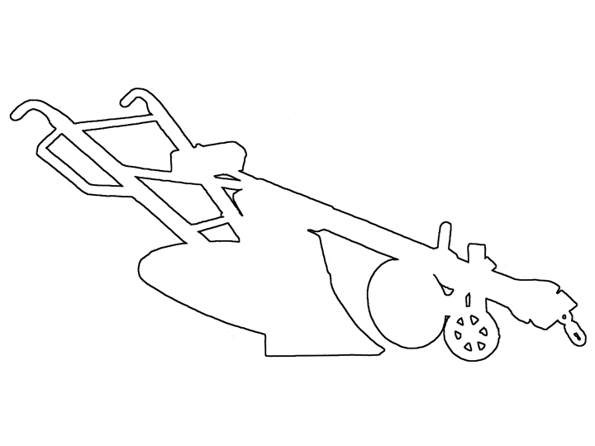
plow

Slide 42
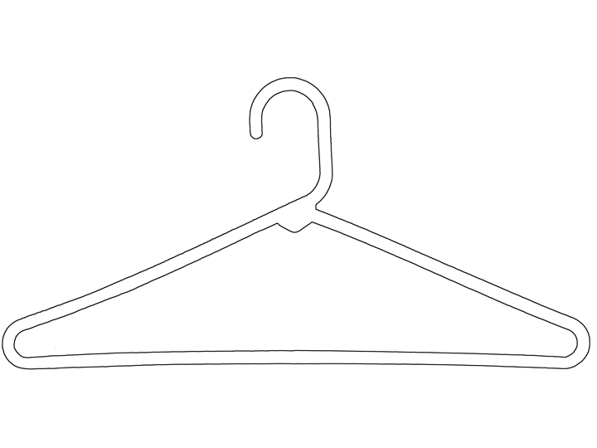
coat hanger

Slide 43
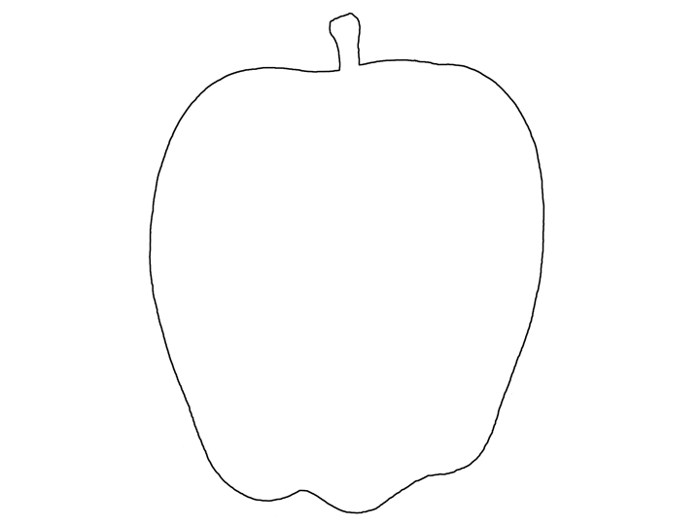
apple

Slide 44
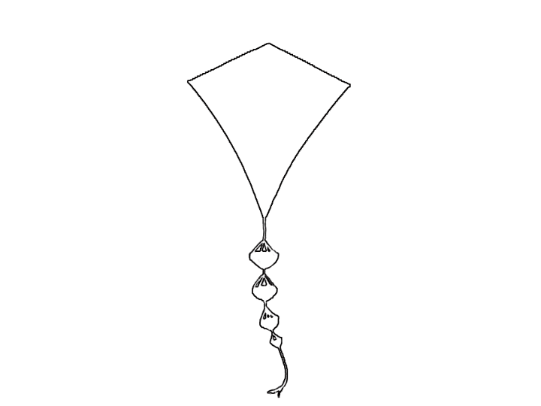
kite

Slide 45
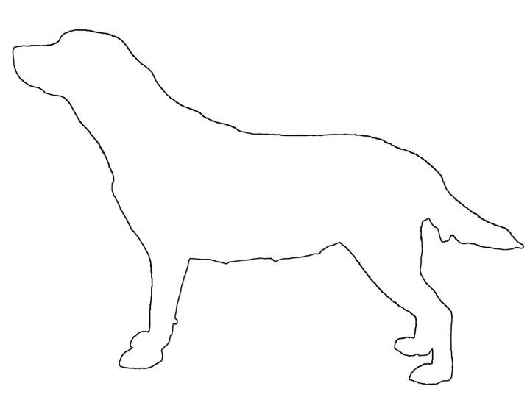
dog

Slide 46
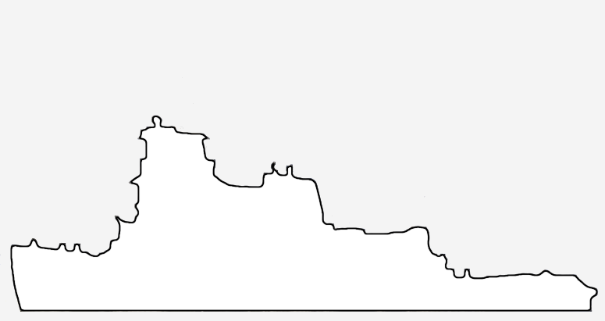
cherry

Slide 47
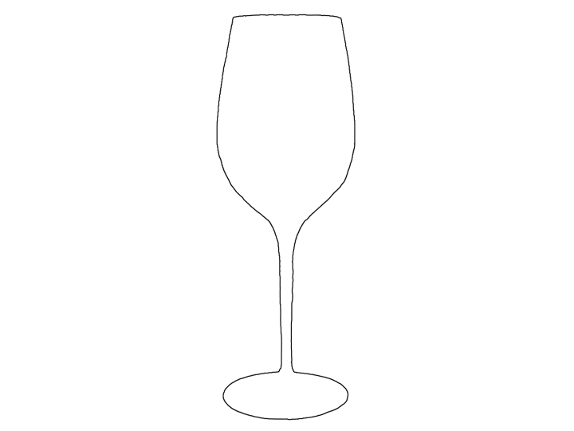
wineglass

Slide 48
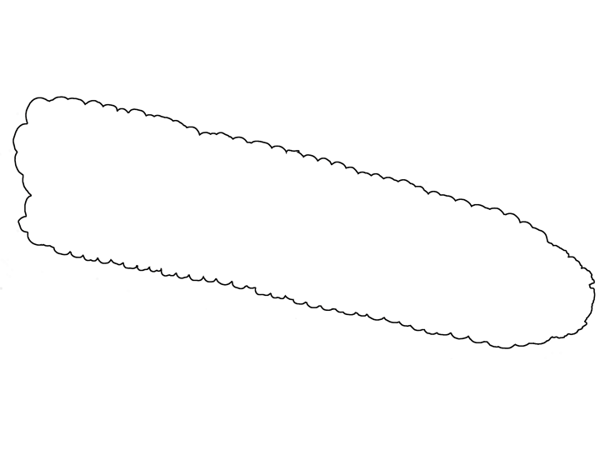
corn

Slide 49
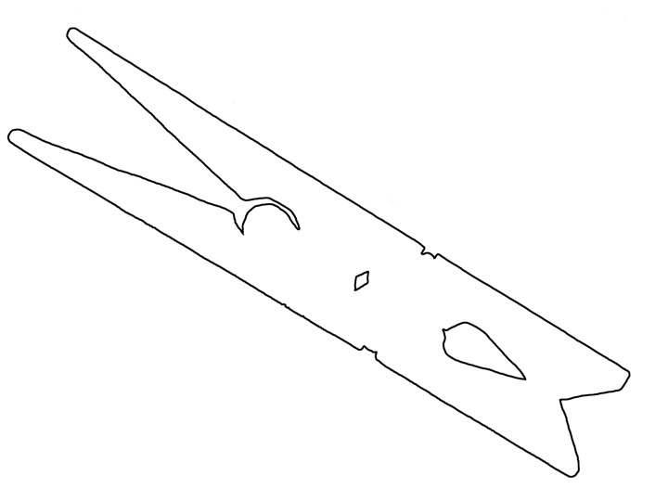
clothespin

Slide 50
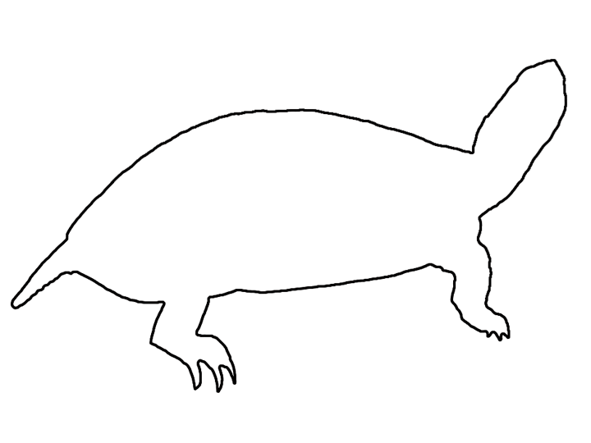
turtle

Slide 51
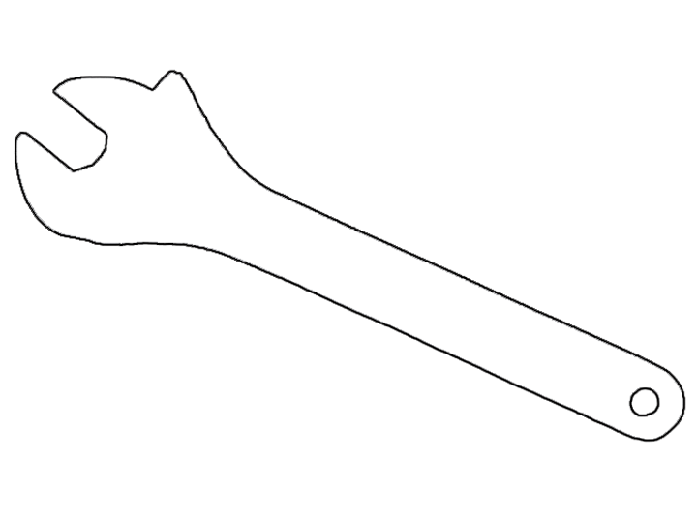
wrench

Slide 52
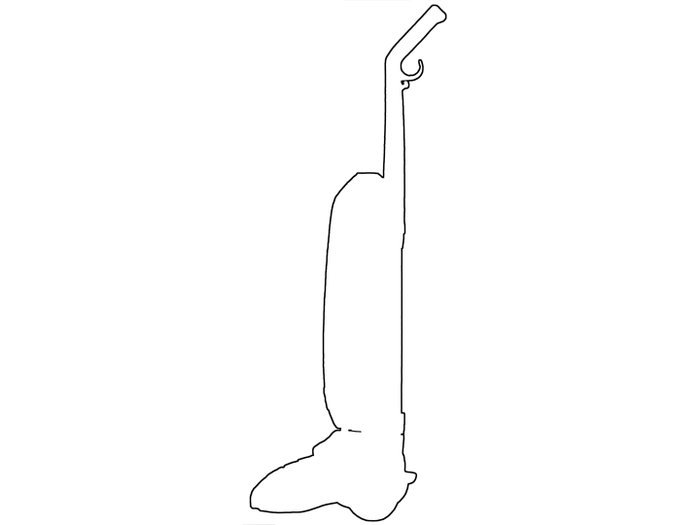
vacuum

Slide 53

bicycle

Slide 54

cleaver

Slide 55

handcuffs

Slide 56

starfish

Slide 57

ice cream cone

Slide 58

airplane

Slide 59

jeep

Slide 60

pencil sharpener

Slide 61

crown

Slide 62

wheelbarrow

Slide 63

shark

Slide 64

hypodermic needle

Slide 65

strawberry

Slide 66

watering can

Slide 67

alarm clock

Slide 68

bat

Slide 69

duck

Slide 70

hammer

Slide 71

shoe

Slide 72

sheep

Slide 73

crowbar

Slide 74

pear

Slide 75

scale

Slide 76

lemon

Slide 77

motorcycle

Slide 78

egg

Slide 79

paperclip

Slide 80

snail

Slide 81

shirt

Slide 82

headphones

Slide 83

mushroom

Slide 84

sailboat

Slide 85

lizard

Slide 86

toothbrush

Slide 87

candelabra

Slide 88

snake

Slide 89

fly

Slide 90

c-clamp

Slide 91

stool

Slide 92

tow truck

Slide 93

camera

Slide 94

flag

Slide 95

fire truck

Slide 96

abacus

Slide 97

anchor

Slide 98

pen

Slide 99

sock

Slide 100

drill

Slide 101

hourglass

Slide 102

milk carton

Slide 103

television

Slide 104

chair

Slide 105

bucket

Slide 106

car

Slide 107

seal

Slide 108

hippo

Slide 109

bison

Slide 110

wreath

Slide 111

safety pin

Slide 112

gramophone

Slide 113

hockey stick

Slide 114

leaf

Slide 115

grasshopper

Slide 116

horseshoe

Slide 117

shovel

Slide 118

cactus

Slide 119

drumstick

Slide 120

gorilla

Slide 121

pocketknife

Slide 122

broccoli

Slide 123

rake

Slide 124

stamp

Slide 125

tractor

Slide 126

eyeglasses

Slide 127

butcher knife

Slide 128

tea kettle

Slide 129

coke bottle

Slide 130

pinecone

Slide 131

boot

Slide 132

pig

Slide 133

house

Slide 134

hot air balloon

Slide 135

harp

Slide 136

deer

Slide 137

candlestick

Slide 138

pipe

Slide 139

bell

Slide 140

rocket

Slide 141

cardinal

Slide 142

bread

Slide 143

table

Slide 144

ostrich

Slide 145

scissors

Slide 146

penguin

Slide 147

revolver

Slide 148

violin

Slide 149

teepee

Slide 150

dragonfly

Slide 151

windmill

Slide 152

comb

Slide 153

camel

Slide 154

tree

Slide 155

tricycle

Slide 156

football

Slide 157

umbrella

Slide 158

garbage truck

Slide 159

signal light

Slide 160

cement truck

Slide 161

swan

Slide 162

gardening shears

Slide 163

carrot

Slide 164

teddy bear

Slide 165

trombone

Slide 166

wine bottle

Slide 167

lighthouse

Slide 168

cat

Slide 169

spatula

Slide 170

Christmas tree

Slide 171

broom

Slide 172

pliers

Slide 173

yoke

Slide 174

sword

Slide 175

French horn

Slide 176

watch

Slide 177

binoculars

Slide 178

funnel

Slide 179

ladle

Slide 180

hammock

Slide 181

dart

Slide 182

rooster

Slide 183

fox

Slide 184

paintbrush

Slide 185

goat

Slide 186

giraffe

Slide 187

compass

Slide 188

flamingo

Slide 189

bow (weapon)

Slide 190

ladder

Slide 191

birthday cake

Slide 192

spider

Slide 193

lobster

Slide 194

cow

Slide 195

ice skates

Slide 196

park bench

Slide 197

rabbit

Slide 198

school bus

Slide 199

fishing hook

Slide 200

octopus

Slide 201

lamp

Slide 202

fire hydrant

Slide 203

caterpillar

Slide 204

feather

Slide 205

mailbox

Slide 206

ring

Slide 207

stethoscope

Slide 208

telephone

Slide 209

megaphone

Slide 210

golf club

Slide 211

acorn

Slide 212

tooth

Slide 213

cone

Slide 214

rattle

Slide 215

bowling pin

Slide 216

battery

Slide 217

seahorse

Slide 218

helmet

Slide 219

crane

Slide 220

protractor

Slide 221

hand

Slide 222

bridge

Slide 223

palette

Slide 224

spoon

Slide 225

fish

Slide 226

anvil

Slide 227

light bulb

Slide 228

saw

Slide 229

polar bear

Slide 230

asparagus

Slide 231

surfboard

Slide 232

trumpet

Slide 233

crayon

Slide 234

canoe

Slide 235

scooter

Slide 236

church

Slide 237

tripod

Slide 238

crab

Slide 239

horse

Slide 240

helicopter

Slide 241

axe

Slide 242

stapler

Slide 243

button

Slide 244

whisk

Slide 245

apron

Slide 246

chain

Slide 247

stop sign

Slide 248

frog

Slide 249

peanut

Slide 250

snowman

Slide 251

mouse

Slide 252

boomerang

Slide 253

pants

Slide 254

saxophone

Slide 255

baseball bat

Slide 256

kangaroo

Slide 257

bone

Slide 258

cane

Slide 259

flower

Slide 260

iron

Slide 261

fire extinguisher

Slide 262

push pin

Slide 263

jellyfish

Slide 264

parking meter

Slide 265

key

Slide 266

grapes

Slide 267

giraffe

Slide 268

lawnmower

Slide 269

whistle

Slide 270

mittens

Slide 271

shopping cart

Slide 272

fork

Slide 273

piano

Slide 274

dress

Slide 275

necktie

Slide 276

ship

Slide 277

lighter

Slide 278

baby carriage

Slide 279

tape dispenser

Slide 280

sewing needle

Slide 281

rolling pin

Slide 282

fan (antique)

Slide 283

shell

Slide 284

beetle

Slide 285

mug

Slide 286

screwdriver

Slide 287

wheelbarrow

Slide 288

igloo

Slide 289

accordion

Slide 290

bed

Slide 291

giraffe

Slide 292

wagon

Slide 293

cherry

Slide 294

wheelbarrow

Slide 295

igloo

Slide 296

accordion

Slide 297

bed

Slide 298

wagon

Slide 299

cherry

Slide 300

wheelbarrow

Slide 301

igloo

Slide 302

accordion

Slide 303

bed

Slide 304

wagon

Slide 305

cherry

Slide 306

igloo

Slide 307

accordion

Slide 308

giraffe

Slide 309

wagon

Slide 310

cherry

Slide 311

wheelbarrow

Slide 312

igloo

Slide 313

accordion

Slide 314

bed

Slide 315

giraffe

Slide 316

wagon

Slide 317

cherry

Slide 318

cherry

Slide 319

cherry

Slide 320

cherry

Slide 321

cherry

Slide 322

cherry

Slide 323
The End

